Slide 1

AREA I
DIAGNOSTIC EXAM

Slide 2
1. This classification of safety sign features a white symbol and/or text on a green background.
  Regulatory Sign
  Emergency Information Sign
  Warning Sign
  Prohibition Sign

Slide 3
1. This classification of safety sign features a white symbol and/or text on a green background.
  Regulatory Sign
  Emergency Information Sign
  Warning Sign
  Prohibition Sign
Notes:
Regulatory Sign: These signs usually have a white background with black symbols or text, and they provide instructions that must be followed (e.g., speed limits, stop signs, etc.). They are not typically green.
Warning Sign: These signs often have a yellow or orange background with black symbols or text to indicate potential hazards or unsafe conditions. They alert individuals to possible dangers or hazards.
Prohibition Sign: These signs typically have a red circle with a diagonal line and a black symbol or text on a white background. They indicate actions that are not allowed (e.g., no smoking, no entry).

Slide 4

Emergency Information Sign

Slide 5
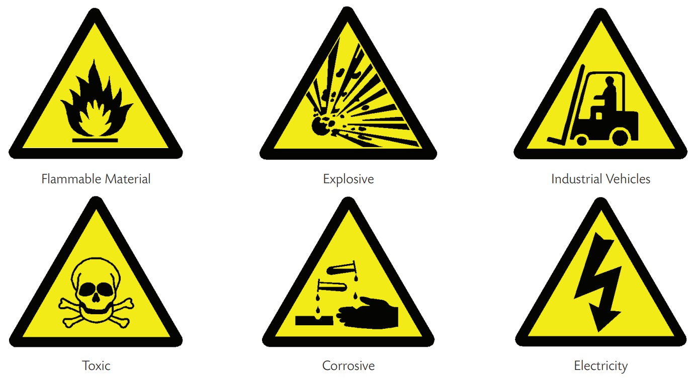
Warning Sign
A sign giving a warning of a hazard or danger.
These signs are generally triangular, with a black pictogram, yellow background, and black edging. A warning sign indicates a potential hazard, obstacle, or condition requiring special attention.

Slide 6

Prohibition Sign
A sign prohibiting behavior likely to increase or cause danger.
These signs are round in shape, with a black pictogram on a white background, red edging, and a diagonal line. A prohibition sign shall show only what or who is forbidden.

Slide 7
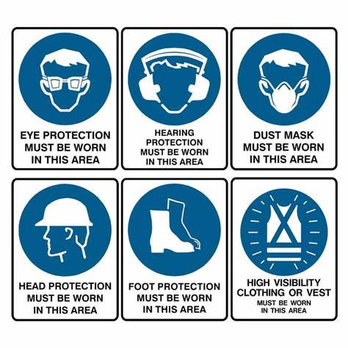
Mandatory Safety Sign
Mandatory signs command a specific action that must be followed in certain circumstances.
They are used for such commands as “Do This”, “You Must”, or “Obey” to protect people from possible dangers where precautions are needed.
They appear as a white imagery or symbol and text within a blue circle on a white frame.
These mandatory signs can also appear with just a single word without any symbol or imagery.
The words are written in black on a rectangular white background.

Slide 8
2. The distance from the center of the crankshaft to the center of the crankpin.
  Crank-throw
  Cam shaft
  Crank rod
  Crank stroke

Slide 9
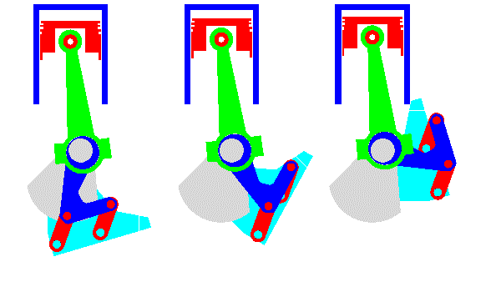
2. The distance from the center of the crankshaft to the center of the crankpin.
  Crank-throw
  Cam shaft
  Crank rod
  Crank stroke

Slide 10
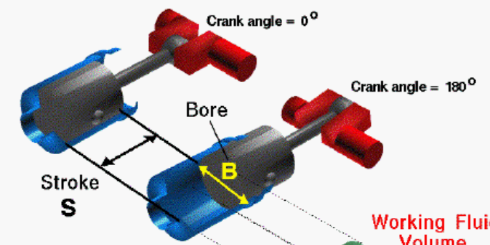


Slide 11
3. A tractor with a 7-in pulley is belted to a prony brake having a 21-in pulley. If the tractor engine pulley speed is 950 rpm, the brake arm is 54 in, and the net load is 60 lb., what is the hp developed?
  2,930.31 hp
  48.84 hp
  1,611,673.031 ft-lb/min
  1,465.16 hp

Slide 12
3. A tractor with a 7-in pulley is belted to a prony brake having a 21-in pulley. If the tractor engine pulley speed is 950 rpm, the brake arm is 54 in, and the net load is 60 lb., what is the hp developed?
  2,930.31 hp
  48.84 hp
  1,611,673.031 ft-lb/min
  1,465.16 hp

Slide 13
4. Artificial Lighting Systems provide precise control over the specific needs of different crops and growth stages. What color is meaningful for plant morphology?
  Blue-rays
  Green rays
  Red rays
  FR rays

Slide 14
4. Artificial Lighting Systems provide precise control over the specific needs of different crops and growth stages. What color is meaningful for plant morphology?
  Blue-rays
  Green rays
  Red rays
  FR rays

Slide 15
5. No coconut tree or trees shall be cut unless a permit therefore, upon due application being made, has been issued by the PCA pursuant to Section 6 of the Republic Act No. 10593. The applicant shall pay an application fee in the amount of _________ for every tree intended to be cut payable to the PCA.
  50
  100
  250
  500

Slide 16
5. No coconut tree or trees shall be cut unless a permit therefore, upon due application being made, has been issued by the PCA pursuant to Section 6 of the Republic Act No. 10593. The applicant shall pay an application fee in the amount of _________ for every tree intended to be cut payable to the PCA.
  50
  100
  250
  500

Slide 17
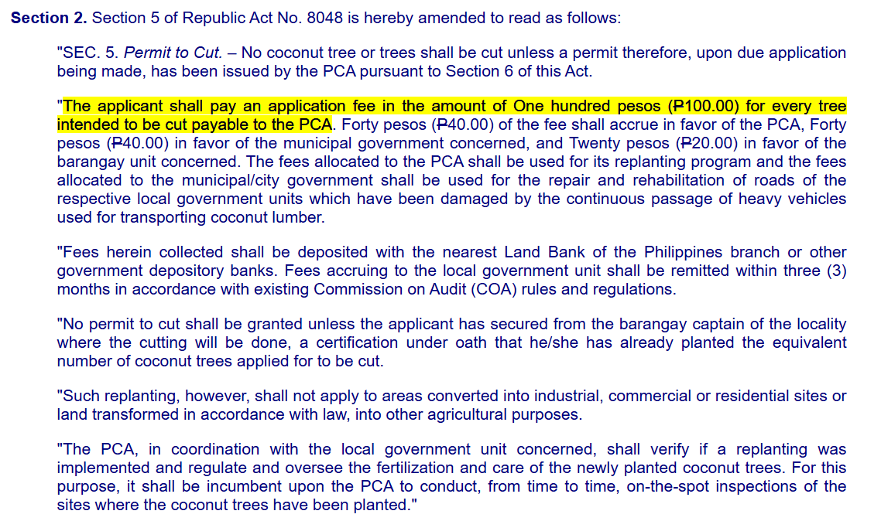

Slide 18
6. Theoretically, the intake valve:
  opens at BDC/closes at BDC
  opens at TDC/closes at TDC
  opens at BDC/closes at TDC
  opens at TDC/ closes at BDC

Slide 19
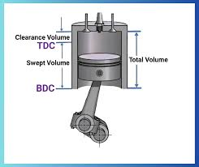
6. Theoretically, the intake valve:
  opens at BDC/closes at BDC
  opens at TDC/closes at TDC
  opens at BDC/closes at TDC
  opens at TDC/ closes at BDC

Slide 20
7. Mr. Mars plans to buy a van for the delivery of his agricultural products. He can buy a European model that will have a first cost of Php 22 000, an operating cost of Php 2 000 per year, and a salvage value of Php 12 000 after 3 years. Alternatively, he can buy a Japanese model that will have a first cost of Php 26 000, an operating cost of Php 1 200 per year, and a Php 15 000 resale value after 3 years. At an interest rate of 15% per year, which model should Mr. Mars buy?
  European model at Php -18 676
  Japanese model at Php -18 877
  European model at Php -18 877
  Japanese model at Php -18 676
Notes:
PW=−P−A(P/A,i,n)+F(P/F,i,n)

Slide 21
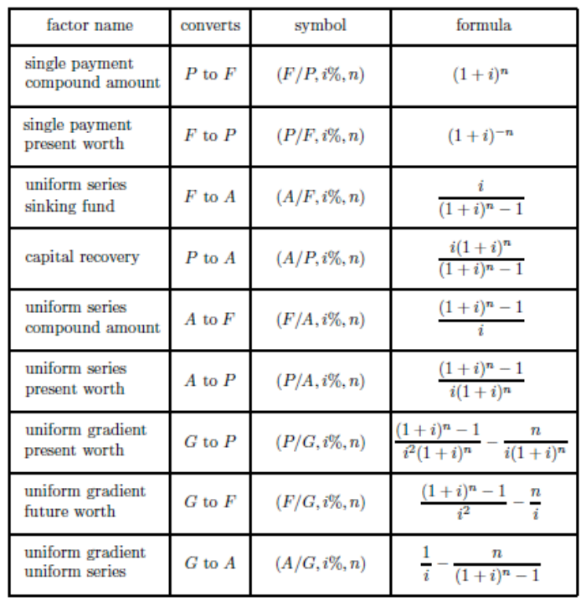
Notes:
PW=−P−A(P/A,i,n)+F(P/F,i,n)

Slide 22
7. Mr. Mars plans to buy a van for the delivery of his agricultural products. He can buy a European model that will have a first cost of Php 22 000, an operating cost of Php 2 000 per year, and a salvage value of Php 12 000 after 3 years. Alternatively, he can buy a Japanese model that will have a first cost of Php 26 000, an operating cost of Php 1 200 per year, and a Php 15 000 resale value after 3 years. At an interest rate of 15% per year, which model should Mr. Mars buy?
  European model at Php -18 676
  Japanese model at Php - 18 877
  European model at Php - 18 877
  Japanese model at Php - 18 676

Slide 23
8. These are activities which create faster and more efficient performance of other marketing activities.
  Transactional activities
  Physical handling and distribution of products
  Facilitating activities
  Agroservices activities

Slide 24
8. These are activities which create faster and more efficient performance of other marketing activities.
  Transactional activities
  Physical handling and distribution of products
  Facilitating activities
  Agroservices activities
Notes:
In marketing, facilitating activities are those that support and enhance the efficiency and effectiveness of other core marketing activities. These activities don't directly involve the exchange or physical distribution of the product but help to make these processes smoother, faster, and more effective.
Examples of Facilitating Activities:
Market Research: Gathering data about consumer preferences, trends, and behaviors to guide decisions.
Financing: Providing credit or financing options to customers or partners.
Advertising and Promotion: Helping create awareness and demand, making transactions smoother.
Logistics Support: Coordination to ensure timely delivery and availability of products.
These activities facilitate the core transactional and physical distribution activities by ensuring everything works more efficiently.
Why the Other Options Are Incorrect:
Transactional Activities: These are directly involved with the exchange process, like buying and selling, negotiating prices, and transferring ownership. These activities focus on the transaction itself, not the support processes.
Physical Handling and Distribution of Products: These involve the actual movement and storage of goods. This is a crucial marketing activity, but it's not classified as a facilitating activity. It's part of the core functions that help get the product to the consumer.
Agroservices Activities: These are specialized services provided to support agricultural practices, such as crop management, irrigation, or pest control. They are service-oriented but don't encompass the broader facilitating activities in marketing.

Slide 25
9. This republic act is a game-changing piece of legislation curated to enhance the existing procurement systems under the 21-year-old Government Procurement Reform Act.
  Republic Act (RA) No. 9184
  Republic Act (RA) No. 1989
  Republic Act (RA) No. 12009
  Republic Act (RA) No. 10902

Slide 26
9. This republic act is a game-changing piece of legislation curated to enhance the existing procurement systems under the 21-year-old Government Procurement Reform Act.
  Republic Act (RA) No. 9184 - Government Procurement Reform Act of 2016
  Republic Act (RA) No. 1989
  Republic Act (RA) No. 12009
  Republic Act (RA) No. 10902

Slide 27
10. If an electric motor rated at 220 volts and 4.8 amperes is converted to 110 volts, then its rated current will be:
  2.4 A
  4.8 A
  7.2 A
  9.6 A

Slide 28
10. If an electric motor rated at 220 volts and 4.8 amperes is converted to 110 volts, then its rated current will be:
  2.4 A
  4.8 A
  7.2 A
  9.6 A
Notes:
P1 ​= V1 ​× I1 ​= 220 V × 4.8 A = 1056 W
1056 W = 110 V × I2​

Slide 29
11. An agricultural and biosystems engineer shall be required to indicate on the documents he/she signs, uses or issues in connection with the practice of his/her profession all of the following EXCEPT:
  date of registration
  professional license number
  the duration of its validity
  professional tax receipt number

Slide 30
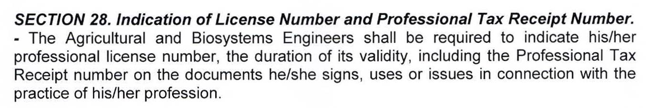
Excerpt from RA10915 IRR

Slide 31
11. An agricultural and biosystems engineer shall be required to indicate on the documents he/she signs, uses or issues in connection with the practice of his/her profession all of the following EXCEPT:
  date of registration
  professional license number
  the duration of its validity
  professional tax receipt number

Slide 32
12. Which of the following is NOT true about the statements below:
  Diesel includes the heaviest oils used in internal combustion engine.
  Excessive ignition lag results in the accumulation of unburned fuel which when subjected to high pressure and temperature may detonate giving rise to the diesel knock.
  Low cetane fuel permits an engine to be started at lower temperature.
  The lowest temperature at which the fuel ceases to flow is known as pour point

Slide 33
12. Which of the following is NOT true about the statements below:
  Diesel includes the heaviest oils used in internal combustion engine.
  Excessive ignition lag results in the accumulation of unburned fuel which when subjected to high pressure and temperature may detonate giving rise to the diesel knock.
  Low cetane fuel permits an engine to be started at lower temperature.
  The lowest temperature at which the fuel ceases to flow is known as pour point
Notes:
Cetane number is a measure of the ignition quality of diesel fuel. A higher cetane number means that the fuel ignites more easily, which is desirable for easier cold starts and smooth engine operation. On the other hand, low cetane fuel has poorer ignition quality and is harder to ignite, especially at lower temperatures. Therefore, low cetane fuel actually requires higher temperatures to start the engine effectively, rather than allowing it to start at lower temperatures.
Diesel fuels are heavier and less refined compared to gasoline and typically have a higher density. Diesel engines use this heavier fuel because it contains more energy per liter, which is suitable for combustion in high-compression engines.
Diesel knock occurs when there is a delay in ignition (ignition lag), causing an explosive detonation of unburned fuel in the combustion chamber. This can result in rough engine operation, often referred to as "knocking.“
The pour point is the lowest temperature at which a fuel will flow under standard testing conditions. This property is important for ensuring that fuel remains fluid in cold weather conditions, allowing it to flow and be pumped to the engine.

Slide 34
13. Arrange the following according to the process of management.
i. Selecting the right employees for the right position
ii. Formulation of the mission, vision, goals, objectives and activities of the organization
iii. Conducting of annual performance evaluation of employees.
iv. Coordinating the employees and material resources of the organization.
v. Orientation of personnel for the proper achievement of goals
  i, ii, iii, iv, v
  ii, iv, i, iii, v
  ii, i, v, iv, iii
  ii, iv, i, v, iii

Slide 35
13. Arrange the following according to the process of management.
i. Selecting the right employees for the right position
ii. Formulation of the mission, vision, goals, objectives and activities of the organization
iii. Conducting of annual performance evaluation of employees.
iv. Coordinating the employees and material resources of the organization.
v. Orientation of personnel for the proper achievement of goals
  i, ii, iii, iv, v
  ii, iv, i, iii, v
  ii, i, v, iv, iii
  ii, iv, i, v, iii
Notes:
ii. Formulation of the mission, vision, goals, objectives, and activities of the organization (The management process starts with setting the overall direction and purpose for the organization. This step involves defining the organization's mission and vision, establishing goals and objectives, and planning the activities that will help achieve these goals.)
i. Selecting the right employees for the right position (once the organization’s goals and objectives are set, the next step is to recruit and select the employees who will help achieve them. This involves ensuring that the right people are hired for the right roles based on their skills, qualifications, and fit with the organization's needs.)
v. Orientation of personnel for the proper achievement of goals (once employees are hired, they need to be properly oriented to the organization. This involves familiarizing them with the organization’s culture, values, goals, and expectations so they can effectively contribute to achieving the objectives.)
iv. Coordinating the employees and material resources of the organization (coordination is the next step after orientation. Management must ensure that resources (both human and material) are aligned and utilized effectively in the pursuit of the organization's goals. This involves overseeing the activities and ensuring that everything runs smoothly, efficiently, and in alignment with the goals.)
iii. Conducting of annual performance evaluation of employees (After coordinating and executing activities, it’s essential to evaluate employee performance to measure progress, provide feedback, and make necessary adjustments for future improvement.)

Slide 36
14. Mr. Rick Riordan noticed that the percentage of unthreshed rice crop is relatively high when using his rice combine harvester. Determine the cause of this problem.
  The header may be too high
  Weak airflow from the fan
  Clogged fuel lines due to neglected filters
  Flow on the concave screen is blocked due to high moisture content

Slide 37
14. Mr. Rick Riordan noticed that the percentage of unthreshed rice crop is relatively high when using his rice combine harvester. Determine the cause of this problem.
  The header may be too high
  Weak airflow from the fan
  Clogged fuel lines due to neglected filters
  Flow on the concave screen is blocked due to high moisture content

Slide 38
15. Why are farm revenues higher in years of lower production due to bad weather?
  Demand is more elastic than supply
  Supply is perfectly elastic
  Demand is inelastic
  Supply is inelastic

Slide 39
15. Why are farm revenues higher in years of lower production due to bad weather?
  Demand is more elastic than supply
  Supply is perfectly elastic
  Demand is inelastic
  Supply is inelastic
Notes:
In economics, inelastic demand refers to a situation where the quantity demanded of a good does not significantly change in response to price changes. In contrast, elastic demand means that a small price change leads to a significant change in quantity demanded.
When bad weather reduces the supply of agricultural products (like crops), the supply curve shifts leftward, meaning the quantity available decreases. If the demand is inelastic, the quantity demanded does not decrease much in response to higher prices because consumers still need the product, even at higher prices.
As a result:
Prices rise because of the decreased supply.
Revenues can increase despite lower quantities being sold because the price increase compensates for the reduced supply.
Why the other options are not correct:
Demand is more elastic than supply: If demand were elastic, the price increase from reduced supply would lead to a significant reduction in the quantity demanded. This would lower, rather than raise, revenues.
Supply is perfectly elastic: This would mean that the quantity supplied can increase or decrease without affecting the price. However, agricultural supply is usually not perfectly elastic because it's affected by factors like weather and land limitations.
Supply is inelastic: While it's true that agricultural supply can be inelastic (meaning it cannot quickly adjust to changes), the key factor in this case is demand, not supply. Supply being inelastic doesn't directly explain the higher revenues due to weather-related production issues.

Slide 40
16. The specific fuel consumption of a tractor is 0.3lbs/BHP-hr. If the heating value is 19,500BTU/lb., what is the Brake Thermal Efficiency?
  435%
  23.05%
  230%
  43.5%

Slide 41
16. The specific fuel consumption of a tractor is 0.3lbs/BHP-hr. If the heating value is 19,500BTU/lb., what is the Brake Thermal Efficiency?
  435%
  23.05%
  230%
  43.5%
Notes:
$$\frac{1}{\text{(0.3} \frac{lb}{BHP−hr}\text{ ∗ 19,500} \frac{BTU}{lb}\text{)} \text{∗} \frac{1 HP}{2545.5 BTU/hr} }$$
Specific Fuel Consumption (SFC) is a measure of the fuel efficiency of an engine, particularly in relation to its power output. It represents the amount of fuel consumed by the engine to produce a certain amount of power over a specific time period.
If an engine consumes 0.3 pounds of fuel per brake horsepower per hour (0.3 lbs/BHP-hr), this means that for every 1 horsepower the engine produces, it uses 0.3 pounds of fuel every hour.
Brake Thermal Efficiency (BTE) is a measure of the efficiency of an internal combustion engine in converting the energy contained in the fuel into useful mechanical work (brake power). It represents the percentage of the energy in the fuel that is effectively used to produce work, as opposed to being lost as heat or other forms of energy.
A higher brake thermal efficiency means that the engine is converting a larger proportion of the energy in the fuel into useful work. It indicates a more efficient engine.
A lower brake thermal efficiency means that more of the fuel’s energy is being lost as heat, which is typically the case with engines that have poor combustion efficiency or are not well-designed.

Slide 42
17. A 4-stroke, 4-cylinder engine having a cylinder dimension of 25 by 20 cm rotates at 154 rpm. What is the IHP when the IMEP is 7.5 kPa.
  0.51 hp
  24.35 hp
  0.41 hp
  30.43 hp

Slide 43
17. A 4-stroke, 4-cylinder engine having a cylinder dimension of 25 by 20 cm rotates at 154 rpm. What is the IHP when the IMEP is 7.5 kPa.
  0.51 hp
  24.35 hp
  0.41 hp
  30.43 hp
Notes:
IHP = PLANn/33000 C (English Unit); IHP = PLANn/746 C (SI)
For 4-stroke engines, power is generated every two revolutions of the crankshaft, so you effectively use half the displacement volume per revolution.
For 2-stroke engines, power is generated every single revolution, so the full displacement volume is used.

Slide 44
18. According to International Standard Organization (ISO), there are three (3) choices for a signal word. Which of the following does NOT belong to the group?
  NOTICE
  CAUTION
  WARNING
  DANGER

Slide 45
18. According to International Standard Organization (ISO), there are three (3) choices for a signal word. Which of the following does NOT belong to the group?
  NOTICE
  CAUTION
  WARNING
  DANGER
Notes:
The International Standard Organization (ISO) defines three signal words used to indicate the level of hazard associated with a product or situation:
DANGER – Used for the most severe level of hazard.
WARNING – Used for moderately severe hazards.
CAUTION – Used for the least severe hazards.
NOTICE does not belong to this group, as it is typically used to indicate information or instructions, not a level of hazard. It is not associated with a level of danger or severity, unlike the other three.

Slide 46

Notes:
The International Standard Organization (ISO) defines three signal words used to indicate the level of hazard associated with a product or situation:
DANGER – Used for the most severe level of hazard.
WARNING – Used for moderately severe hazards.
CAUTION – Used for the least severe hazards.
NOTICE does not belong to this group, as it is typically used to indicate information or instructions, not a level of hazard. It is not associated with a level of danger or severity, unlike the other three.

Slide 47
19. All Agricultural and Biosystems Engineers shall establish and maintain good relations with fellow Agricultural and Biosystems Engineers and other allied professionals and, accordingly, shall:
  a. Refrain from publicly expressing opinion on any Agricultural and Biosystems Engineering-related issue unless they are well-informed of the facts relating thereto.
  b. Avoid engaging in any activity or practice that would taint or be detrimental to the interest, dignity and honor of the profession.
  c. Disclose clearly the consequences that might arise if deviations from their Agricultural and Biosystems Engineering works or opinion would be overruled by nontechnical authority.
  d. Refrain from associating with Agricultural and Biosystems Engineers who engage in unethical or illegal practices, and who refuse to share responsibility for their work.

Slide 48
19. All Agricultural and Biosystems Engineers shall establish and maintain good relations with fellow Agricultural and Biosystems Engineers and other allied professionals and, accordingly, shall:
  a. Refrain from publicly expressing opinion on any Agricultural and Biosystems Engineering-related issue unless they are well-informed of the facts relating thereto.
  b. Avoid engaging in any activity or practice that would taint or be detrimental to the interest, dignity and honor of the profession.
  c. Disclose clearly the consequences that might arise if deviations from their Agricultural and Biosystems Engineering works or opinion would be overruled by nontechnical authority.
  d. Refrain from associating with Agricultural and Biosystems Engineers who engage in unethical or illegal practices, and who refuse to share responsibility for their work.
Notes:
Reference: [ PRC BOARD OF AGRICULTURAL ENGINEERING RESOLUTION NO. 02, May 12, 2005 ]
THE CODE OF ETHICS AND PROFESSIONAL STANDARDS FOR AGRICULTURAL ENGINEERS

Slide 49
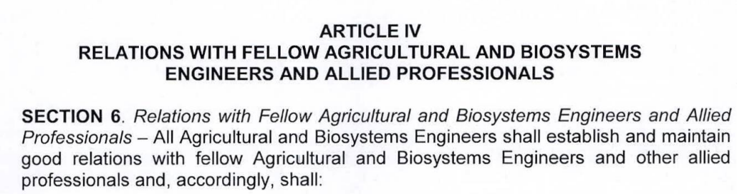
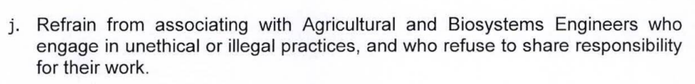
https://www.prc.gov.ph/sites/default/files/2023-05%20publishedAgriBio.pdf

Slide 50
20. A farmer loans 247 100 pesos from a bank with an interest at 5% compounded annually. He agrees to pay his obligations by paying eight equal annual payments, the first being due at the end of 10 years. Find the annual payments.
  53 931.18
  59 310.01
  56 485.72
  56 627.74
Notes:
P=A⋅(P/A,i,n)⋅(P/F,i,9)

Slide 51
Notes:
P=A⋅(P/A,i,n)⋅(P/F,i,9)

Slide 52
20. A farmer loans 247 100 pesos from a bank with an interest at 5% compounded annually. He agrees to pay his obligations by paying eight equal annual payments, the first being due at the end of 10 years. Find the annual payments.
  53 931.18
  59 310.01
  56 485.72
  56 627.74

Slide 53
21. What change in the loading of a ball bearing will cause the expected life to be quartered?
  26%
  37%
  48%
  59%

Slide 54
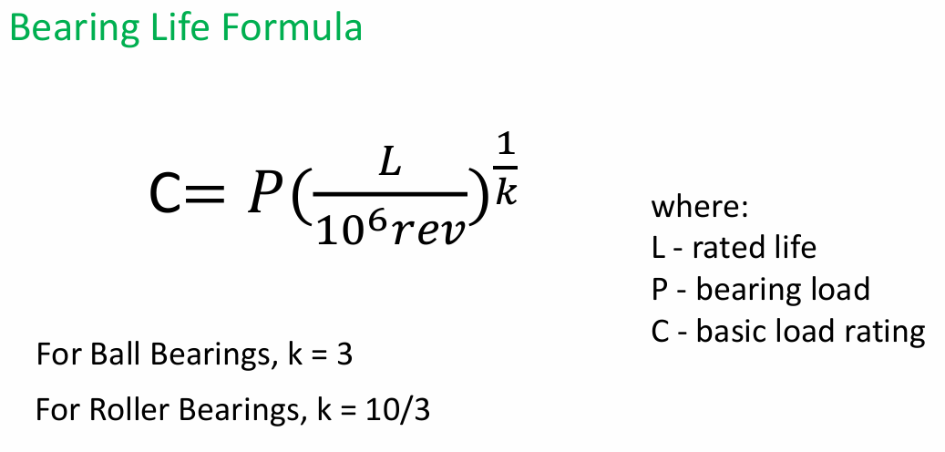

Slide 55
21. What change in the loading of a ball bearing will cause the expected life to be quartered?
  26%
  37%
  48%
  59%

Slide 56
22. A type of logic gate which requires at least one of the input signals to be TRUE for the output to be TRUE.
  OR gate
  XOR gate
  NOT gate
  NOR gate

Slide 57
22. A type of logic gate which requires at least one of the input signals to be TRUE for the output to be TRUE.
  OR gate
  XOR gate
  NOT gate
  NOR gate
Notes:
OR Gate: The output is TRUE if at least one input is TRUE.
XOR Gate: The output is TRUE if exactly one input is TRUE, but not both.
NOT Gate: It inverts the input; if the input is TRUE, the output will be FALSE, and vice versa.
NOR Gate: The output is TRUE only if both inputs are FALSE.

Slide 58
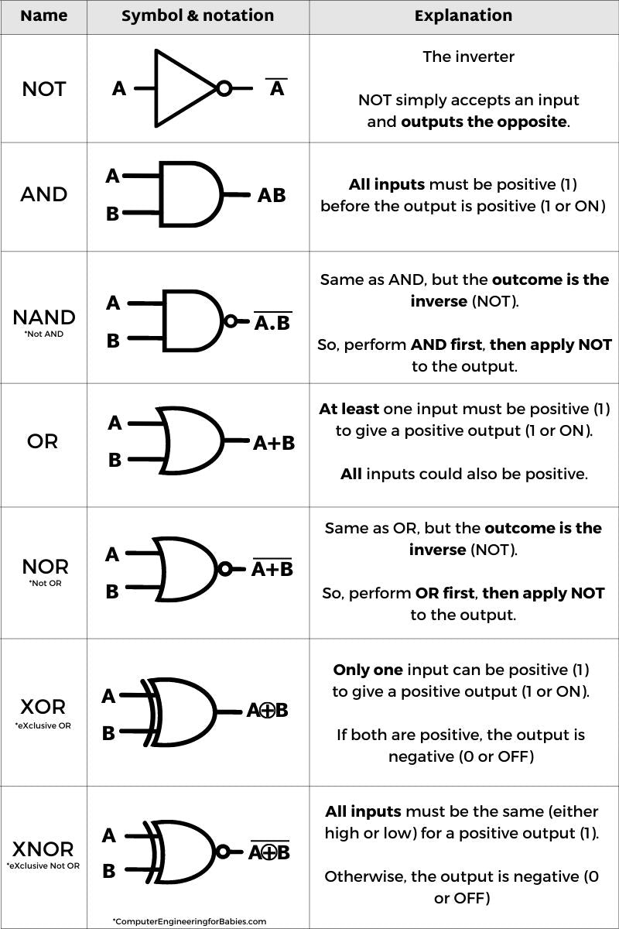
Notes:
OR Gate: The output is TRUE if at least one input is TRUE.
XOR Gate: The output is TRUE if exactly one input is TRUE, but not both.
NOT Gate: It inverts the input; if the input is TRUE, the output will be FALSE, and vice versa.
NOR Gate: The output is TRUE only if both inputs are FALSE.

Slide 59
23. If a store sells 500 bottles of perfume a month when the price is P6, and only sells 460 bottles a month when the price rises to P7, then the price elasticity of demand is:
  0.54 and inelastic
  1.85 and elastic
  1.85 and inelastic
  0.54 and elastic

Slide 60
23. If a store sells 500 bottles of perfume a month when the price is P6, and only sells 460 bottles a month when the price rises to P7, then the price elasticity of demand is:
  0.54 and inelastic
  1.85 and elastic
  1.85 and inelastic
  0.54 and elastic
Notes:
$$PED=\frac{Percentage Change in Quantity}{Percentage Change in Price}=\frac{\frac{460−500}{\frac{500+460}{2}}}{\frac{7−6}{\frac{7+6}{2}}}=0.54$$
Elastic demand occurs when the price elasticity of demand (PED) is greater than 1. This means that the quantity demanded changes by a larger percentage than the percentage change in price.
Inelastic demand occurs when the price elasticity of demand (PED) is less than 1. This means that the quantity demanded changes by a smaller percentage than the percentage change in price.
If PED = 1, the demand is said to be unitary elastic, meaning the percentage change in quantity demanded is exactly equal to the percentage change in price.

Slide 61
24. Engines are not normally used for
  4-wheel tractors
  4-row harvesters
  power sprayers
  1-ton rice mills

Slide 62
24. Engines are not normally used for
  4-wheel tractors
  4-row harvesters
  power sprayers
  1-ton rice mills
Notes:
4-wheel tractors: These tractors often use engines for mobility and to operate attachments or implements.
4-row harvesters: These machines usually require engines to operate and harvest multiple rows of crops simultaneously.
Power sprayers: These are used for spraying pesticides or fertilizers and are usually powered by engines to operate the pump and spray mechanisms.
However, 1-ton rice mills typically don't require engines for their operation in the traditional sense. Instead, they often rely on electric motors or other mechanical systems for processing rice. The 1-ton rice mill is more likely to be powered by electricity rather than a combustion engine.

Slide 63
25. Which of the following is CORRECT?
(I) Anything ANDed with a 0 is equal to 0.
(II) Anything ANDed with a 1 is equal to itself.
(III) Anything ORed with a 0 is equal to 0.
(IV) Anything ORed with a 1 is equal to itself
  I,II, and III are correct.
  I, II and IV are correct.
  II, III, and IV are correct.
  All are correct.

Slide 64
25. Which of the following is CORRECT?
(I) Anything ANDed with a 0 is equal to 0.
(II) Anything ANDed with a 1 is equal to itself.
(III) Anything ORed with a 0 is equal to 0.
(IV) Anything ORed with a 1 is equal to itself
  I,II, and III are correct.
  I, II and IV are correct.
  II, III, and IV are correct.
  All are correct.
Notes:
(I) Anything ANDed with a 0 is equal to 0.
True. In Boolean logic, if you perform an AND operation with 0 (i.e., 0 AND X), the result is always 0, regardless of the other value. This follows the rule: X AND 0=0
(II) Anything ANDed with a 1 is equal to itself.
True. In Boolean logic, if you perform an AND operation with 1 (i.e., 1 AND X), the result is always the value of X. This follows the rule: X AND 1=X
(III) Anything ORed with a 0 is equal to 0.
False. In Boolean logic, if you perform an OR operation with 0 (i.e., 0 OR X), the result is always X, not 0. This rule should be: X OR 0=X
(IV) Anything ORed with a 1 is equal to itself.
True. In Boolean logic, if you perform an OR operation with 1 (i.e., 1 OR X), the result is always 1, regardless of X This follows the rule: X OR 1=1

Slide 65
26. A field measuring 45 m X 90 m is to be prepared using a 1-m upland power tiller at a speed of 3 kph. Assume a 10% overlap between passings and 9 seconds turnaround time at the end of each pass. Determine the field efficiency in going the longer field direction.
  77%
  80%
  83%
  86%

Slide 66
26. A field measuring 45 m X 90 m is to be prepared using a 1-m upland power tiller at a speed of 3 kph. Assume a 10% overlap between passings and 9 seconds turnaround time at the end of each pass. Determine the field efficiency in going the longer field direction.
  77%
  80%
  83%
  86%
Notes:
$$\text{No}\text{. }\text{of} \text{rows}=\frac{45 m}{1 m −(10\% ∗1m)}=50 rows$$
$$time of tilling=\frac{50 rows ∗\frac{90 m}{row}}{3000 m/hr}=1.5 hrs$$
$$turnaround time=50 rows ∗9\frac{seconds}{row}∗\frac{1 hr}{3600 s}=0.125 hr$$
T = 1.5 + 0.125 = 1.625 hr
$$Actual FC= \frac{45 m ∗90 m}{1.625 hr}∗\frac{1ha}{10,000m^{2}}=0.25\frac{ha}{hr}$$
$$eff=\frac{AFC}{TFC}=\frac{0.25}{.1∗3∗1}=83\%$$

Slide 67
27. The seal of the PRBABE shows an inner circle space in white color, the representation of a globe with a light blue droplet of water in which the year ______ is embedded, indicating the year of enactment of RA No. 3927, the first Philippine Agricultural Engineering Law.
  1964
  1977
  1997
  1934

Slide 68
27. The seal of the PRBABE shows an inner circle space in white color, the representation of a globe with a light blue droplet of water in which the year ______ is embedded, indicating the year of enactment of RA No. 3927, the first Philippine Agricultural Engineering Law.
  1964
  1977
  1997
  1934
Notes:
RA No. 3927 is the Philippine Agricultural Engineering Law, which was enacted in 1964. The law established the practice of agricultural engineering in the Philippines, and the seal of the Professional Regulation Commission (PRC) Agricultural and Biosystems Engineering (PRBABE) reflects this with the year 1964 embedded in the design.

Slide 69

Notes:
RA No. 3927 is the Philippine Agricultural Engineering Law, which was enacted in 1964. The law established the practice of agricultural engineering in the Philippines, and the seal of the Professional Regulation Commission (PRC) Agricultural and Biosystems Engineering (PRBABE) reflects this with the year 1964 embedded in the design.

Slide 70
28. In line with the national Organic Agricultural Program, the BAFPS shall submit to the Board for approval the following, EXCEPT:
  a. A plan of bringing the program down to the grassroots, utilizing available personnel and facilities on the local level and those of LGUs
  b. A status of the programs, projects and activities undertaken for the development and promotion of organic agriculture
  c. A pattern of cooperation and mutual assistance with LGUs, POs and NGOs, which will maximize people empowerment and participatory approaches to program formulation, implementation and monitoring
  d. A schedule of short-term, medium-term and long-term targets on research and development, marketing, trade promotion/initiatives, capacity building, among others.

Slide 71
28. In line with the national Organic Agricultural Program, the BAFPS shall submit to the Board for approval the following, EXCEPT:
  a. A plan of bringing the program down to the grassroots, utilizing available personnel and facilities on the local level and those of LGUs
  b. A status of the programs, projects and activities undertaken for the development and promotion of organic agriculture
  c. A pattern of cooperation and mutual assistance with LGUs, POs and NGOs, which will maximize people empowerment and participatory approaches to program formulation, implementation and monitoring
  d. A schedule of short-term, medium-term and long-term targets on research and development, marketing, trade promotion/initiatives, capacity building, among others.

Slide 72
29. The transfer of the NIA from the Office of the President to the Department of Agriculture is through what executive order?
  Executive Order No. 165 (s. 2014)
  Executive Order No. 166 (s. 2014)
  Executive Order No. 167 (s. 2014)
  Executive Order No. 168 (s. 2014)

Slide 73
29. The transfer of the NIA from the Office of the President to the Department of Agriculture is through what executive order?
  Executive Order No. 165 (s. 2014)
  Executive Order No. 166 (s. 2014)
  Executive Order No. 167 (s. 2014)
  Executive Order No. 168 (s. 2014)

Slide 74
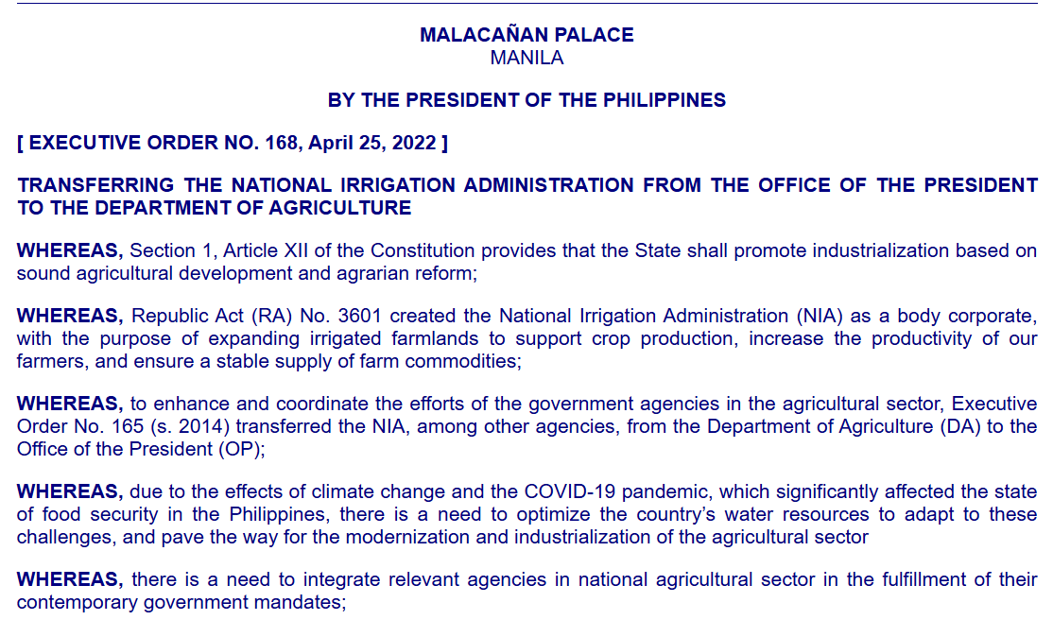
Executive Order No. 168

Slide 75
30. Subject to existing budgetary, accounting and auditing rules and regulations, the Building Official is hereby authorized to retain not more than ______ of his collection for the operating expenses of his office.
  10%
  20%
  30%
  40%

Slide 76
30. Subject to existing budgetary, accounting and auditing rules and regulations, the Building Official is hereby authorized to retain not more than ______ of his collection for the operating expenses of his office.
  10%
  20%
  30%
  40%

Slide 77

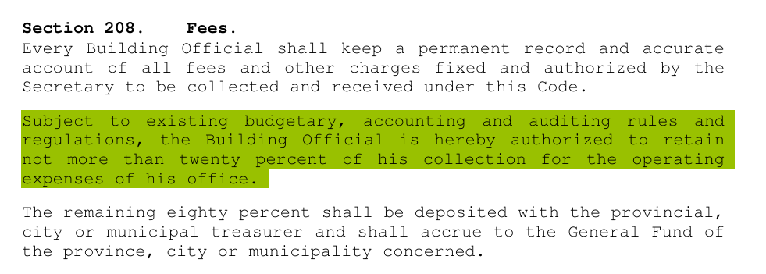
Microsoft Word - mdsPD1096of1977.doc

Slide 78
31. To carry out the policy and the program provided in the Republic Act No. 10068, there is hereby created _______ which shall be the policy-making body and shall provide direction and general guidelines for the implementation of the program.
  NOAB
  BAFE
  BAFPS
  CPES

Slide 79
31. To carry out the policy and the program provided in the Republic Act No. 10068, there is hereby created _______ which shall be the policy-making body and shall provide direction and general guidelines for the implementation of the program.
  NOAB
  BAFE
  BAFPS
  CPES

Slide 80
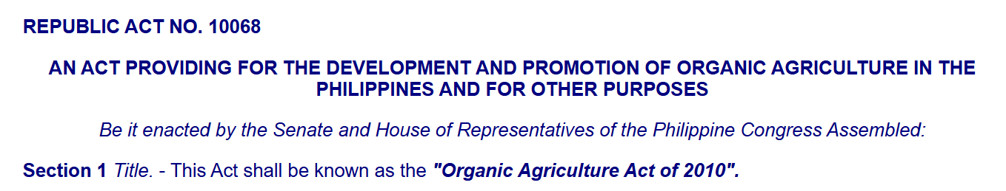
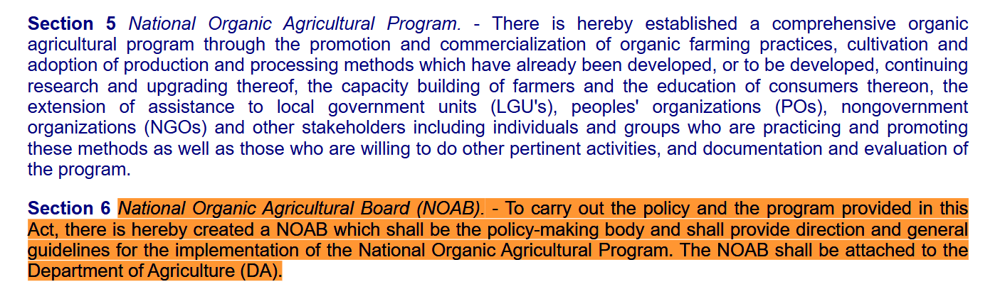
R.A. No. 10068

Slide 81
32. All agricultural and biosystems engineering facilities/projects shall hire or engage the services of at least how many registered and licensed ABE?
  1
  2
  3
  4

Slide 82
32. All agricultural and biosystems engineering facilities/projects shall hire or engage the services of at least how many registered and licensed ABE?
  1
  2
  3
  4

Slide 83
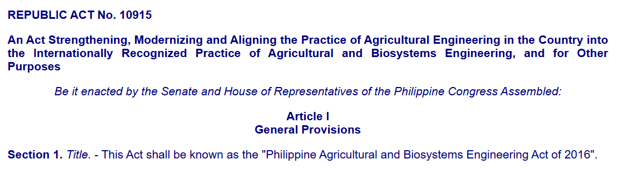
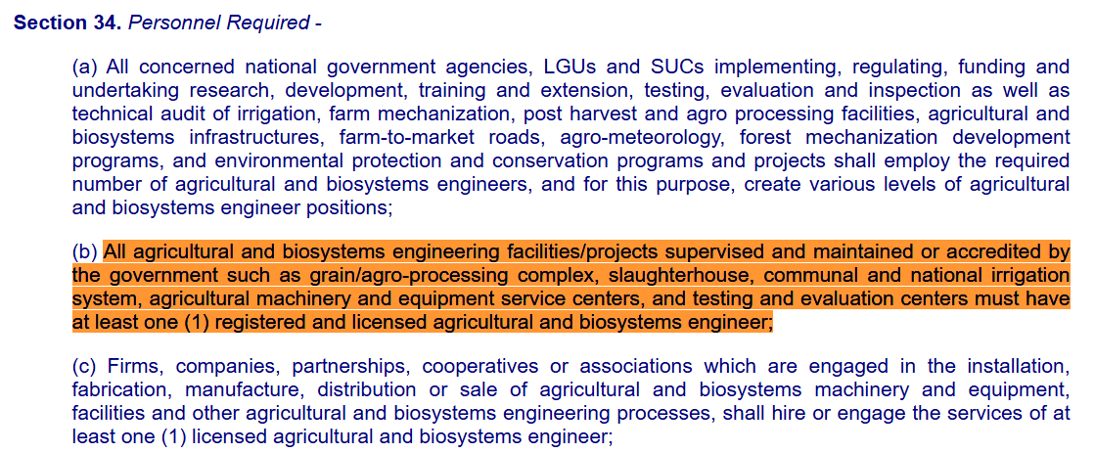
Republic Act No. 10915

Slide 84
33. This Standard specifies the minimum requirements for the fabrication, construction, and performance of egg incubators used for poultry breeding and production.
  PNS/BAFS 356:2023
  PNS/BAFS 357:2023
  PNS/BAFS 358:2023
  PNS/BAFS 359:2023

Slide 85
33. This Standard specifies the minimum requirements for the fabrication, construction, and performance of egg incubators used for poultry breeding and production.
  PNS/BAFS 356:2023
  PNS/BAFS 357:2023
  PNS/BAFS 358:2023
  PNS/BAFS 359:2023

Slide 86
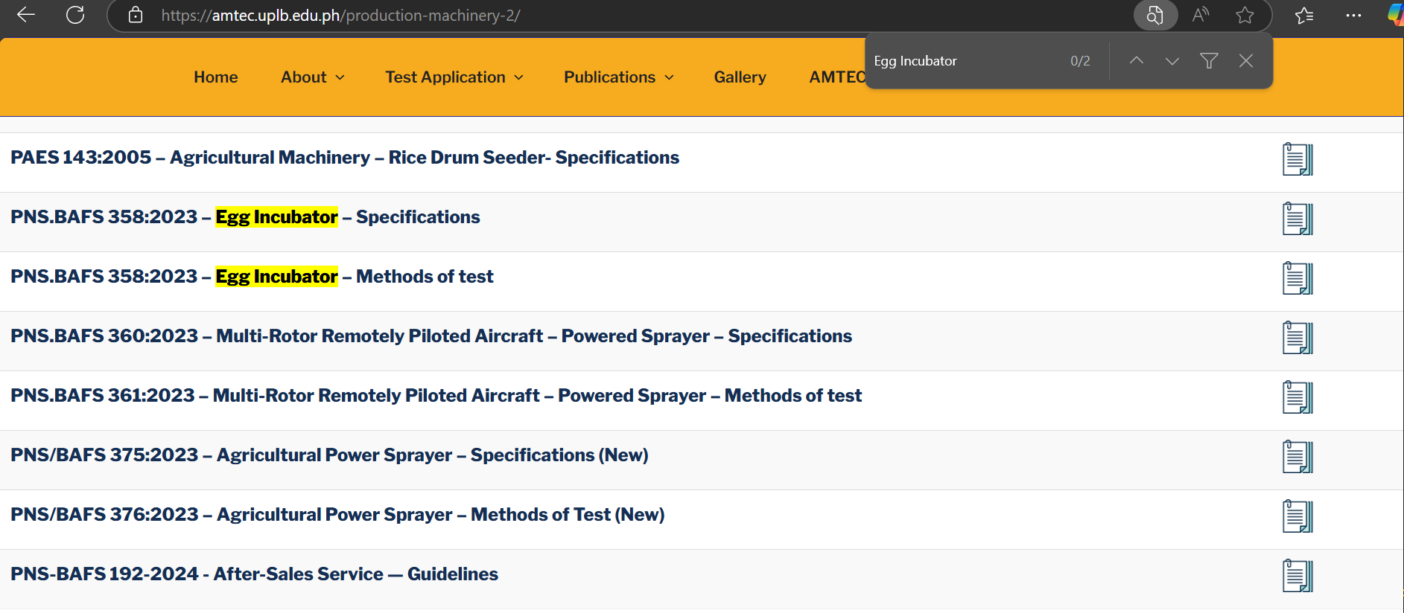

Slide 87
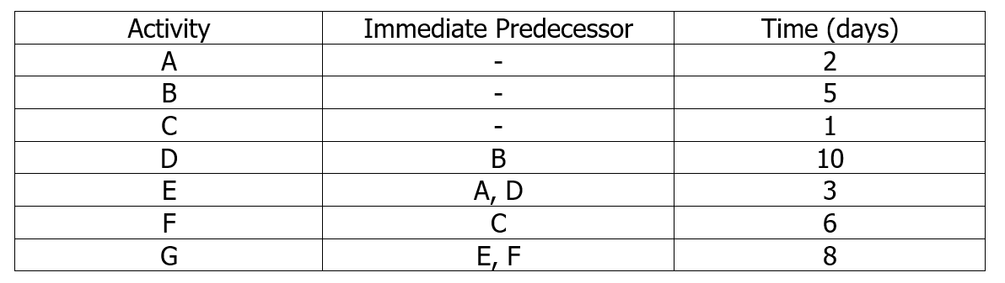
34-35. Jhon Hopkins is developing a program in leadership training for middle-level managers. He had listed a number of activities that must be completed before a training program of this nature can be conducted. The activities, immediate predecessors, and times appear in the accompanying table.

Slide 88
34. What is the critical path?
  B→D→E→G
  C→F→G
  A→E→G
  NOTA
35. What is the total project completion date?
  24 days
  17 days
  13 days
  26 days

Slide 89
34. What is the critical path?
  B→D→E→G
  C→F→G
  A→E→G
  NOTA
35. What is the total project completion date?
  24 days
  17 days
  13 days
  26 days

Slide 90
36. A horizontal mixer is designed to incorporate soil and charcoal for composting laboratory experiment. The motor used series of belt and pulley drives, as follows: D1 = 4 in.; D2 = 12 in.; D3 = 2 in.; D4 = 12 in.; D5 = 2 in.; and D6 = 12 in. Determine the speed of the last shaft if the motor runs at 1720 rpm speed.
  95.55 rpm
  15.9 rpm
  573.3 rpm
  31.8 rpm

Slide 91
36. A horizontal mixer is designed to incorporate soil and charcoal for composting laboratory experiment. The motor used series of belt and pulley drives, as follows: D1 = 4 in.; D2 = 12 in.; D3 = 2 in.; D4 = 12 in.; D5 = 2 in.; and D6 = 12 in. Determine the speed of the last shaft if the motor runs at 1720 rpm speed.
  95.55 rpm
  15.9 rpm
  573.3 rpm
  31.8 rpm
Notes:
N1D1 = N2D2

Slide 92
37. A 5-m self-propelled combine makes an average stop of 4 min every time its 2-ton grain tank is to be unloaded. Gross yield of the 20-ha field is 42 tons. The operating speed is 4.8 kph. The time for turning on the headland at the ends of the 500-m field is 15 seconds. Find the field efficiency.
  78%
  83%
  87%
  90%
Notes:
$$\frac{42}{2}∗\frac{4}{60}=1.4 hours$$
$$\frac{(20∗10000)}{500/5}rows∗\frac{15}{3600}=0.33 hour$$
$$\frac{\left(80 rows ∗500\frac{m}{row}\right)}{4800 m/hr}=8.33 hrs$$
T = 1.4+0.33+8.33 = 10.06 hrs
$$eff=\frac{AFC}{TFC}=\frac{\frac{20}{10.06}}{0.1 ∗ 4.8 ∗5}$$

Slide 93
37. A 5-m self-propelled combine makes an average stop of 4 min every time its 2-ton grain tank is to be unloaded. Gross yield of the 20-ha field is 42 tons. The operating speed is 4.8 kph. The time for turning on the headland at the ends of the 500-m field is 15 seconds. Find the field efficiency.
  78%
  83%
  87%
  90%

Slide 94
38. Determine the performance index of a two-row upland weeder with an effective working width of 500 mm and field efficiency of 75%. The animal pulling the weeder is traveling at 2.5kph and the plant damage is 8% with weeds before using the planter of 400 and weeds after weeding of 30.
  798 ha/h-hp
  797 ha/h-hp
  726 ha/h-hp
  725 ha/h-hp

Slide 95
38. Determine the performance index of a two-row upland weeder with an effective working width of 500 mm and field efficiency of 75%. The animal pulling the weeder is traveling at 2.5kph and the plant damage is 8% with weeds before using the planter of 400 and weeds after weeding of 30.
  798 ha/h-hp
  797 ha/h-hp
  726 ha/h-hp
  725 ha/h-hp
Notes:
The performance index is a measure used to evaluate the efficiency and effectiveness of agricultural machinery in performing a specific task, such as weeding, planting, or harvesting. It helps to quantify how well the machine performs relative to its power output (usually horsepower) and the work it accomplishes over a given period or area.
Perf. Index = $\frac{\text{FC} \text{x} \left(\text{100 −\%}\text{Damage}\right)\text{x} \text{Eff}}{\text{Power}}=\frac{0.1∗2.5∗0.5∗0.75\left(100−8\right)\left(\frac{400−30}{400}\right)}{1}=797\frac{ha}{hr−hp}$

Slide 96
39. What is the field efficiency of a row-crop planter without fertilizer applicator??
  70%
  65%
  60%
  55%

Slide 97
39. What is the field efficiency of a row-crop planter without fertilizer applicator??
  70%
  65%
  60%
  55%

Slide 98
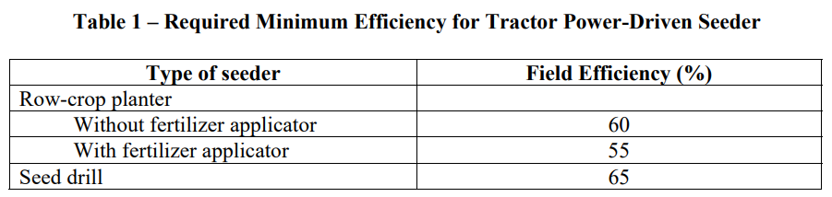

Slide 99
40. A farming field can be plowed by 6 tractors in 4 days. When t tractors work together, each of them ploughs 120 hectares a day. If two of the tractors were moved to another field, then the remaining 4 tractors could plough the same field in 5 days. How many hectares would one tractor plough then?
  144 ha
  120 ha
  169 ha
  225 ha

Slide 100
40. A farming field can be plowed by 6 tractors in 4 days. When t tractors work together, each of them ploughs 120 hectares a day. If two of the tractors were moved to another field, then the remaining 4 tractors could plough the same field in 5 days. How many hectares would one tractor plough then?
  144 ha
  120 ha
  169 ha
  225 ha
Notes:
6*120*4= 2880 ha
4*120*5 = 2400 ha
4 tractors * X ha/tractor/day * 5 days = 2880
20X = 2880
X = 2880/20=144 ha

Slide 101
41. According to PHilMech, the farm mechanization level in the Philippines is now at _____, a marked increase from the 2.31 hp/ha pegged in 2013.
  2.679 hp/ha
  2.769 hp/ha
  2.976 hp/ha
  NOTA

Slide 102
41. According to PHilMech, the farm mechanization level in the Philippines is now at _____, a marked increase from the 2.31 hp/ha pegged in 2013.
  2.679 hp/ha
  2.769 hp/ha
  2.976 hp/ha
  NOTA

Slide 103

Notes:
Based on PHilMech’s assessment, the highest mechanization level was logged in Region 2 with 3.5079 hp/ha, while the lowest was in the Bangsamoro Autonomous Region in Muslim Mindanao (BARRM) with 0.9031 hp/ha.

Slide 104
42. What refers to the market situation in which any given product is supplied by a very large number of vendors and there is no restriction against additional vendors from entering the market??
  Perfect competition
  Oligopoly
  Oligopsony
  Monopoly

Slide 105
42. What refers to the market situation in which any given product is supplied by a very large number of vendors and there is no restriction against additional vendors from entering the market??
  Perfect competition
  Oligopoly
  Oligopsony
  Monopoly
Notes:
In a perfect competition market, there are a large number of vendors supplying an identical product. No restrictions exist for new vendors to enter the market, and each vendor has no control over the price—prices are determined by supply and demand.
Oligopoly: A market where a few large sellers dominate the market, and entry by new competitors is typically difficult due to barriers like high capital costs or patents.
Oligopsony: A market where there are few buyers controlling demand for a product.
Monopoly: A market dominated by a single seller, with no competition and significant barriers to entry for others.

Slide 106
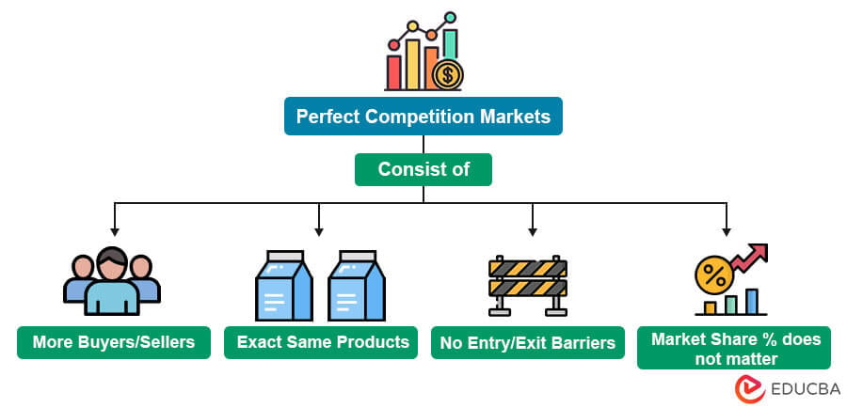
Notes:
In a perfect competition market, there are a large number of vendors supplying an identical product. No restrictions exist for new vendors to enter the market, and each vendor has no control over the price—prices are determined by supply and demand.
Oligopoly: A market where a few large sellers dominate the market, and entry by new competitors is typically difficult due to barriers like high capital costs or patents.
Oligopsony: A market where there are few buyers controlling demand for a product.
Monopoly: A market dominated by a single seller, with no competition and significant barriers to entry for others.

Slide 107
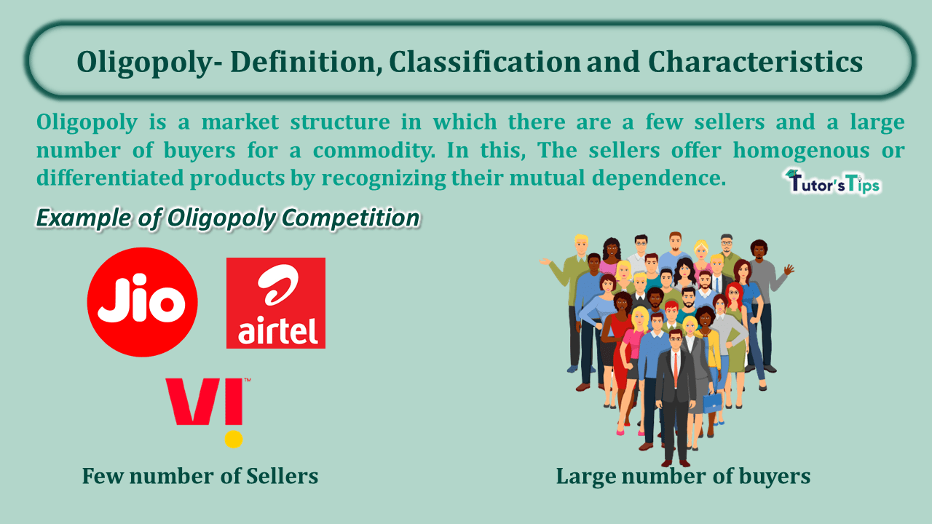
Notes:
In a perfect competition market, there are a large number of vendors supplying an identical product. No restrictions exist for new vendors to enter the market, and each vendor has no control over the price—prices are determined by supply and demand.
Oligopoly: A market where a few large sellers dominate the market, and entry by new competitors is typically difficult due to barriers like high capital costs or patents.
Oligopsony: A market where there are few buyers controlling demand for a product.
Monopoly: A market dominated by a single seller, with no competition and significant barriers to entry for others.

Slide 108


Slide 109
43. API Service Classification for gasoline engine is ________.
  G-series
  S-series
  C-series
  F-series

Slide 110
43. API Service Classification for gasoline engine is ________.
  G-series
  S-series
  C-series
  F-series
Notes:
The API (American Petroleum Institute) Service Classification for gasoline engines uses the S-series. This series is specifically designed for spark ignition engines (gasoline engines).
G-series: Not an API classification for engine oils.
C-series: This is for diesel engine oils (stands for "Compression" engines), like API CF, CJ-4, etc.
F-series: Not a standard API classification.

Slide 111
44. Machine element that transfers loads between rotating and stationary members and permit relatively free rotation with minimum friction.
  key
  shaft
  bearing
  spline

Slide 112
44. Machine element that transfers loads between rotating and stationary members and permit relatively free rotation with minimum friction.
  key
  shaft
  bearing
  spline
Notes:
Key: A key is a component used to secure rotating parts (like a shaft and a wheel) to prevent them from slipping relative to each other. It does not allow rotation itself.
Shaft: A shaft is a component that transmits torque and rotation, but it doesn't specifically reduce friction or support rotation.
Spline: A spline is a mechanical feature used to transmit torque, typically by allowing a keyed connection between a shaft and another component, but it does not specifically reduce friction or support rotation in the same way bearings do.

Slide 113
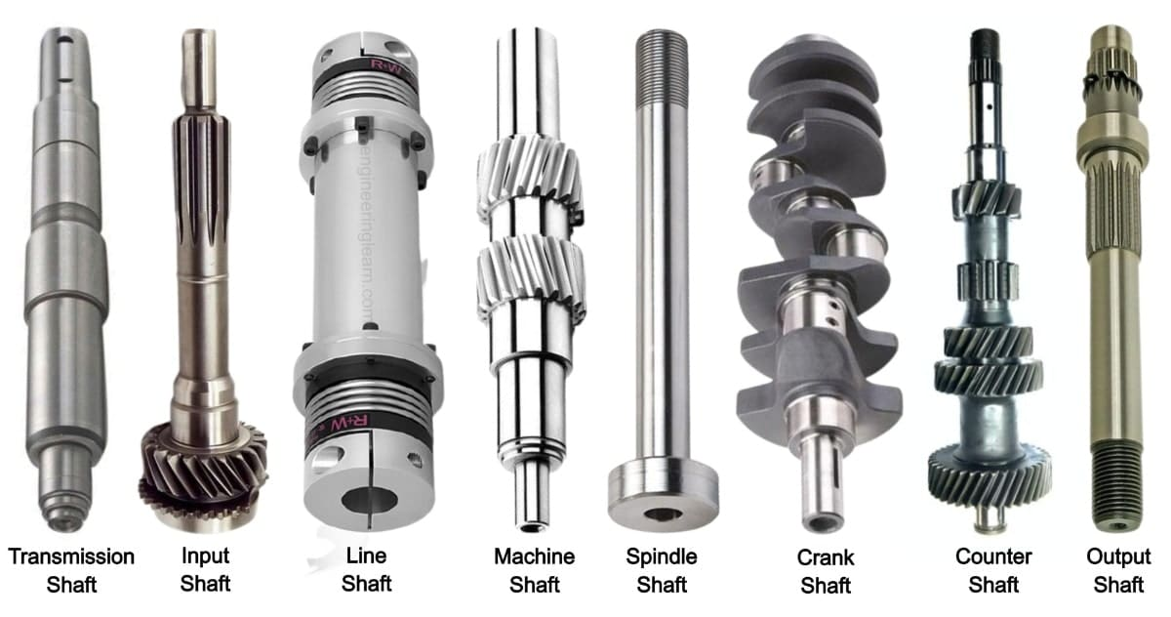
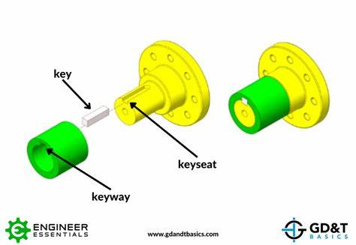
Notes:
Key: A key is a component used to secure rotating parts (like a shaft and a wheel) to prevent them from slipping relative to each other. It does not allow rotation itself.
Shaft: A shaft is a component that transmits torque and rotation, but it doesn't specifically reduce friction or support rotation.
Spline: A spline is a mechanical feature used to transmit torque, typically by allowing a keyed connection between a shaft and another component, but it does not specifically reduce friction or support rotation in the same way bearings do.

Slide 114
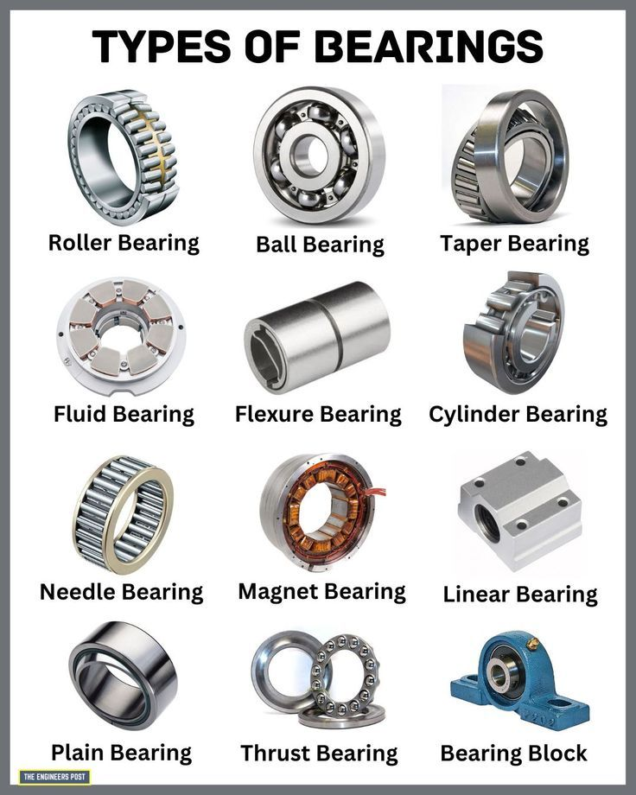
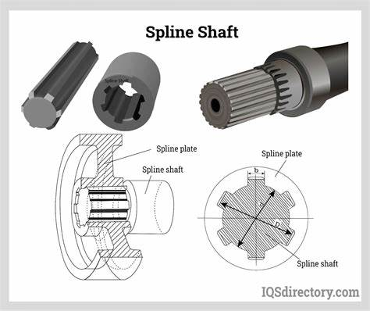
Notes:
Key: A key is a component used to secure rotating parts (like a shaft and a wheel) to prevent them from slipping relative to each other. It does not allow rotation itself.
Shaft: A shaft is a component that transmits torque and rotation, but it doesn't specifically reduce friction or support rotation.
Spline: A spline is a mechanical feature used to transmit torque, typically by allowing a keyed connection between a shaft and another component, but it does not specifically reduce friction or support rotation in the same way bearings do.

Slide 115
45. Which of the following belongs under BiGSHOW Acronym.
I. Biomass III. Geothermal V. Hydro VII. Wind
II. Biofuel L IV. Solar VI. Ocean Thermal
  I,III,IV,V,VI,VII
  I,II,III,IV,VI,VII
  II,III,IV,V,VI,VII
  I,II,III,IV,V,VI,VII

Slide 116
45. Which of the following belongs under BiGSHOW Acronym.
I. Biomass III. Geothermal V. Hydro VII. Wind
II. Biofuel L IV. Solar VI. Ocean Thermal
  I,III,IV,V,VI,VII
  I,II,III,IV,VI,VII
  II,III,IV,V,VI,VII
  I,II,III,IV,V,VI,VII

Slide 117
46. ACME Tractor was made from _______.
  Japan
  USA
  Mexico
  Italy

Slide 118
46. ACME Tractor was made from _______.
  Japan
  USA
  Mexico
  Italy
Notes:
Japan – Yanmar, Kubota
Korea – Goldstar
USA – Kohler, John Deer, Ford Tractor, Briggs Station
UK – Massey Fergyson
Finland – Valtra Velmet
Switzerland – MAG
Brazil – Maxion Tractor
Engines:
Italy – ACME, Ducati
Japan – Honda, Kubota, Robin
China – Mitsubishi, Katsura

Slide 119
47. A flat belt, 8 mm thick and 100 mm wide transmits power between two pulleys, running at 1600 m/min. The mass of the belt is 0.9 kg/m length. The angle of lap in the smaller pulley is 165º and the coefficient of friction between the belt and the pulley is 0.3. If the maximum permissible stress is 2MN/m², find the maximum power transmitted.
  16.29 kW
  14.81 kW
  15.76 kW
  12.48 kW

Slide 120
47. A flat belt, 8 mm thick and 100 mm wide transmits power between two pulleys, running at 1600 m/min. The mass of the belt is 0.9 kg/m length. The angle of lap in the smaller pulley is 165º and the coefficient of friction between the belt and the pulley is 0.3. If the maximum permissible stress is 2MN/m², find the maximum power transmitted.
  16.29 kW
  14.81 kW
  15.76 kW
  12.48 kW

Slide 121
48. An additive is a matter which is added to improve fuel. This type of fuel additive decreases fuel consumption while also speeding up the ignition process in the engine
  Fuel stabilizing additives
  Cetane boosters
  fuel injector detergents
  anti-gel and corrosion additives

Slide 122
48. An additive is a matter which is added to improve fuel. This type of fuel additive decreases fuel consumption while also speeding up the ignition process in the engine
  Fuel stabilizing additives
  Cetane boosters
  fuel injector detergents
  anti-gel and corrosion additives
Notes:
Fuel stabilizing additives: These are used to prevent fuel from deteriorating or spoiling, especially for long-term storage. They don’t speed up ignition or reduce fuel consumption.
Fuel injector detergents: These additives are designed to clean the fuel injectors, improving the fuel spray pattern and overall engine performance. While they help maintain engine efficiency, they do not directly impact fuel consumption or ignition speed.
Anti-gel and corrosion additives: These additives are used in cold weather to prevent fuel from freezing and to protect the engine from rust or corrosion. They don't have an effect on the ignition speed or fuel consumption.

Slide 123
49. It means the seller is responsible for the product only until it is loaded on board a shipping a vessel, at which point the buyer is responsible.
  Cost and Freight
  Free on Board
  Cost, insurance, and freight
  NOTA

Slide 124
49. It means the seller is responsible for the product only until it is loaded on board a shipping a vessel, at which point the buyer is responsible.
  Cost and Freight
  Free on Board
  Cost, insurance, and freight
  NOTA
Notes:
Free on Board (FOB) is an international shipping term used in trade that means: The seller is responsible for the goods only until they are loaded onto the shipping vessel.
Once the goods are on board, the risk and responsibility shift to the buyer, including freight costs, insurance (if not agreed otherwise), and any further handling.
Cost and Freight (CFR): The seller pays for the cost and freight to bring the goods to the destination port, but the risk transfers to the buyer once the goods are loaded on the vessel.
Cost, Insurance, and Freight (CIF): Similar to CFR, but here the seller also provides insurance for the goods up to the destination port. Risk still transfers once the goods are on board.

Slide 125
50. The cash flows associated with a coffee hulling machine are as follows:
Year 0 = - P50,000
Year 1 to 5 = P15,000
At a MARR of 10% per year, calculate the machine's net present value (NPV).
  Php 6,862.00
  Php 4,842.00
  Php 7,317.00
  Php 5,093.00

Slide 126
50. The cash flows associated with a coffee hulling machine are as follows:
Year 0 = - P50,000
Year 1 to 5 = P15,000
At a MARR of 10% per year, calculate the machine's net present value (NPV).
  Php 6,862.00
  Php 4,842.00
  Php 7,317.00
  Php 5,093.00

Slide 127
51. Purpose of extension which aims to achieve societal objectives and collective utilities
  Emancipatory extension
  Formative extension
  Information extension
  Persuasive extension

Slide 128
51. Purpose of extension which aims to achieve societal objectives and collective utilities
  Emancipatory extension
  Formative extension
  Information extension
  Persuasive extension

Slide 129
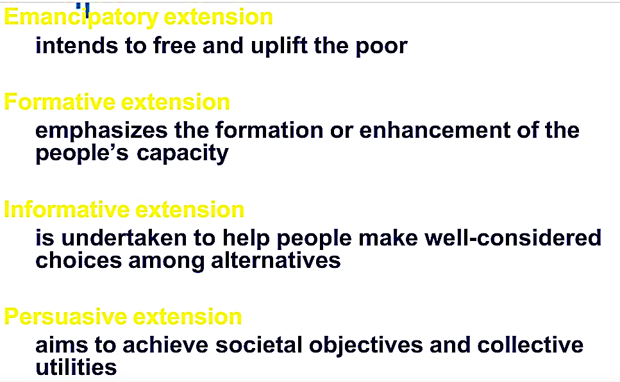

Slide 130
52. A 2-stroke-cycle ICE has 20 explosions per second, what is the engine rpm?
  300 rpm
  2400 rpm
  600 rpm
  1200 rpm

Slide 131
52. A 2-stroke-cycle ICE has 20 explosions per second, what is the engine rpm?
  300 rpm
  2400 rpm
  600 rpm
  1200 rpm
Notes:
In a 2-stroke-cycle internal combustion engine (ICE), there is one explosion (power stroke) for every revolution of the crankshaft. This is because the engine completes a power stroke every time the crankshaft turns.

Slide 132
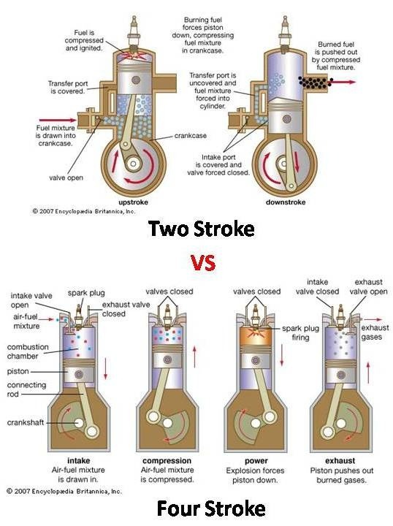

Slide 133
53. Minimum purity (%) for rice combine harvester with fan.
  100
  97
  95
  92

Slide 134
53. Minimum purity (%) for rice combine harvester with fan.
  100
  97
  95
  92

Slide 135
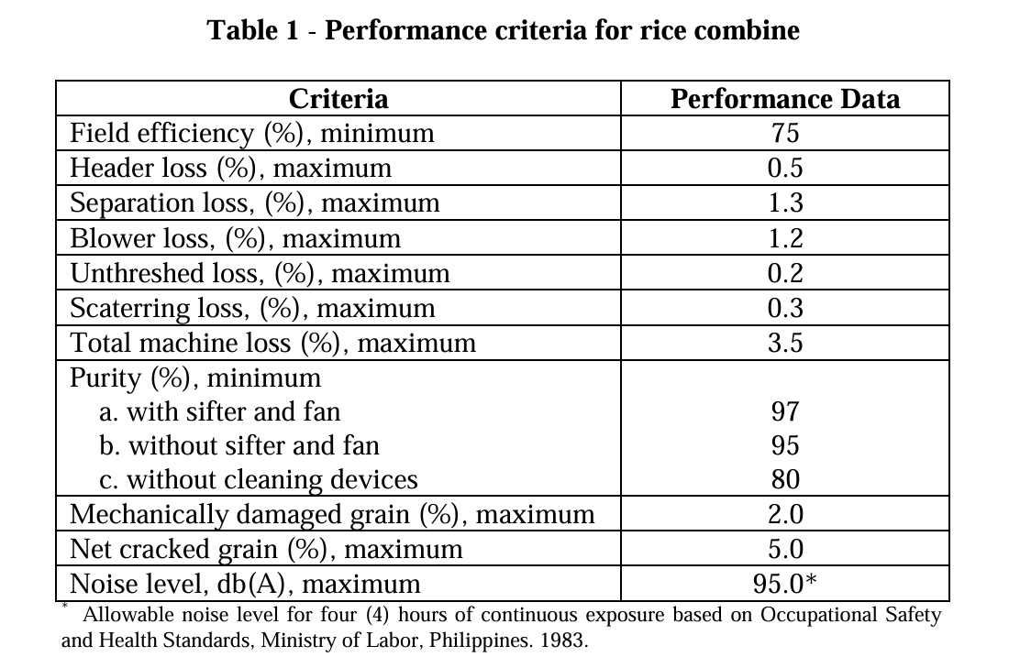
PAES 224 - Rice Combine - Specs

Slide 136
54. Calculate the mechanical efficiency of a 4-stroke engine if the indicated mean effective pressure is 125 psi, displacement is 505 cubic inches, speed is 2200 rpm and torque is 358.1 lb-ft.
  62.77%
  42.78%
  85.57%
  35.56%

Slide 137
54. Calculate the mechanical efficiency of a 4-stroke engine if the indicated mean effective pressure is 125 psi, displacement is 505 cubic inches, speed is 2200 rpm and torque is 358.1 lb-ft.
  62.77%
  42.78%
  85.57%
  35.56%
Notes:
ME=BHP/IHP

Slide 138
55. When excessive amount of water is mixed with the fuel or there is leaky valve set rings, the color of the smoke is _____ of
  Black
  blue
  gray
  AOTA

Slide 139
55. When excessive amount of water is mixed with the fuel or there is leaky valve set rings, the color of the smoke is _____ of
  Black
  blue
  gray
  AOTA
Notes:
Water in the fuel: Water in the fuel can cause incomplete combustion, leading to the production of smoke with a gray color. This is often accompanied by a rough engine performance and a decrease in power.
Leaky valve seats or rings: If the valve seals or piston rings are damaged, oil can leak into the combustion chamber. This oil may burn and produce grayish smoke along with blue or black smoke, depending on the extent of the issue.

Slide 140
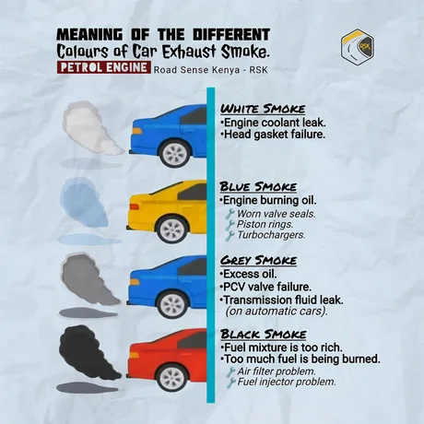
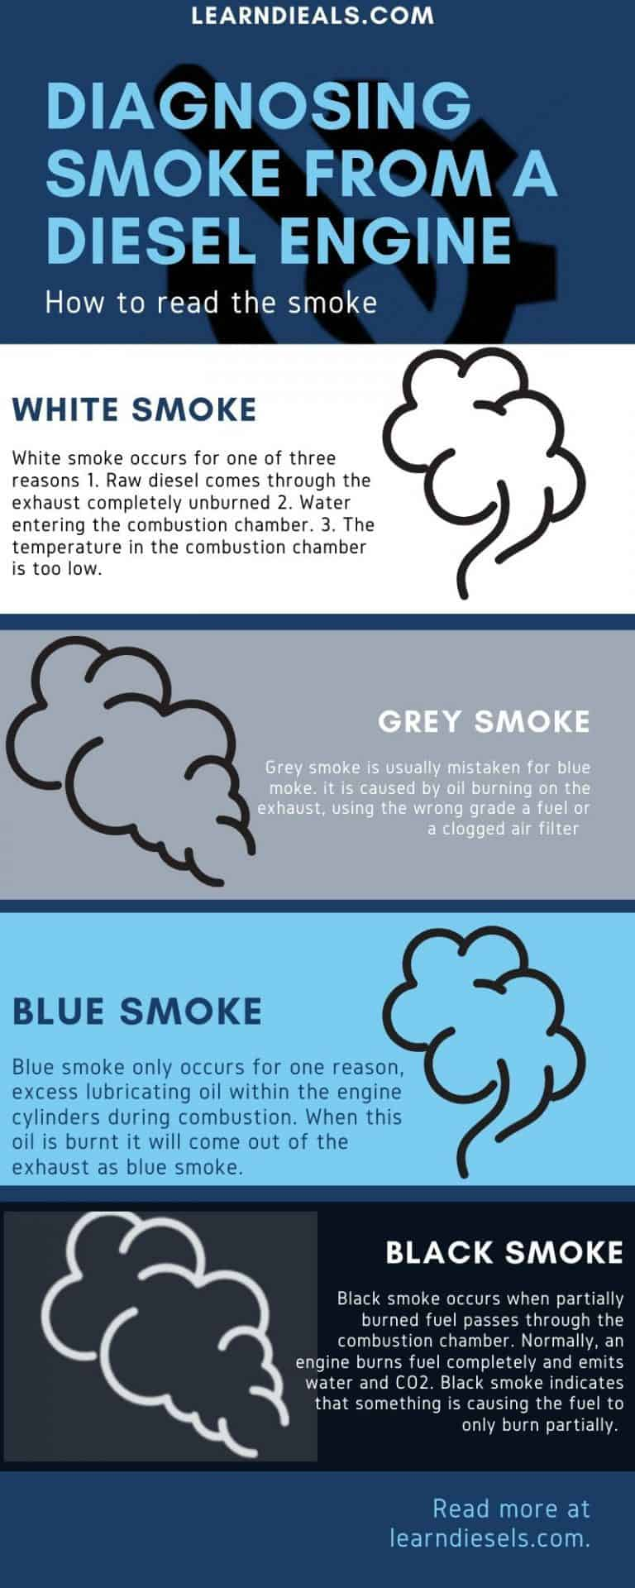

Slide 141
56. Flour, sugar, eggs and butter are examples of what type of agricultural product?
  Raw
  fresh
  Semi-finished
  Processed

Slide 142
56. Flour, sugar, eggs and butter are examples of what type of agricultural product?
  Raw
  fresh
  Semi-finished
  Processed
Notes:
Flour, sugar, eggs, and butter are examples of semi-finished agricultural products.
They are not completely raw (like wheat, sugarcane, or unprocessed milk).
They are not always fresh in the perishable sense (especially flour and sugar).
They are not fully processed into final food products like cake or bread.
They’ve undergone some processing (e.g., milling wheat into flour, extracting and refining sugar, churning cream into butter), making them semi-finished ingredients commonly used in further food preparation.

Slide 143
57. Which of the following is NOT true:
  Electric motors are classified based on electrical service required as single-phase AC and three-phase AC.
  Select a motor whose torque required by the load is always greater than the torque output.
  Motors are built with four insulation classes that can withstand only certain amounts of operating temperature.
  For convenience, nameplate data often gives the maximum ambient temperature that will keep the motor temperature within limits.

Slide 144
57. Which of the following is NOT true:
  Electric motors are classified based on electrical service required as single-phase AC and three-phase AC.
  Select a motor whose torque required by the load is always greater than the torque output.
  Motors are built with four insulation classes that can withstand only certain amounts of operating temperature.
  For convenience, nameplate data often gives the maximum ambient temperature that will keep the motor temperature within limits.

Slide 145
58. __________ percent of the rice fund shall be released to and implemented by the PhilRice and shall be used for the development, propagation and promotion of inbred rice seeds to rice farmers and the organization of rice farmers into seed growers associations and/or cooperatives engaged in seed production and trade.
  10
  30
  50
  25

Slide 146
58. __________ percent of the rice fund shall be released to and implemented by the PhilRice and shall be used for the development, propagation and promotion of inbred rice seeds to rice farmers and the organization of rice farmers into seed growers associations and/or cooperatives engaged in seed production and trade.
  10
  30
  50
  25
Notes:
Based from Rice Tariffication Law

Slide 147
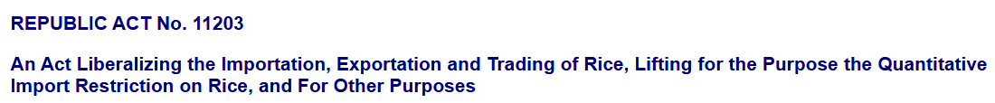
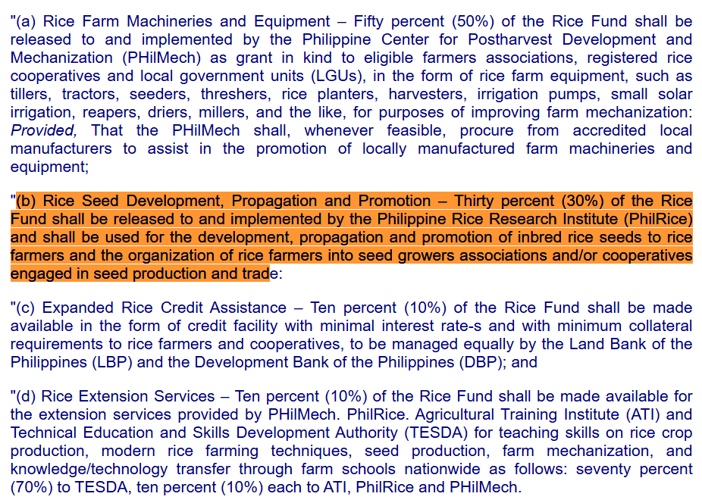
Republic Act No. 11203

Slide 148
59. Determine the exact simple interest on Php 1,700.00 for the period of March 16 to June 14, 2024 at 8% interest.
  Php 33.44
  Php 33.53
  Php 33.81
  Php 33.07

Slide 149
59. Determine the exact simple interest on Php1,700.00 for the period of March 16 to June 14, 2024 at 8% interest.
  Php 33.44
  Php 33.53
  Php 33.81
  Php 33.07
Notes:
$$I=1700∗\left(\frac{90}{366}\right)∗0.08=$$

Slide 150
60. It indicates the maximum load that can be safely carried by the motor under continuous operation.
  Ampacity
  Load rating
  Duty rating
  Service factor

Slide 151
60. It indicates the maximum load that can be safely carried by the motor under continuous operation.
  Ampacity
  Load rating
  Duty rating
  Service factor
Notes:
Load rating refers to the maximum load or output a motor can handle safely and continuously under specified conditions without overheating or sustaining damage.
Ampacity: This is the maximum amount of electric current (in amps) that a conductor (like a wire or cable) can carry safely, not a motor rating.
Duty rating: Indicates how frequently and for how long a motor can run under load (e.g., continuous, intermittent, short-time duty). It relates to the usage pattern, not the maximum load.
Service factor: A multiplier that shows how much overload a motor can handle for short periods. For example, a service factor of 1.15 means the motor can handle 115% of its rated load temporarily.

Slide 152
61. During construction, for contracts which do not involve the supply of construction materials or where the materials are supplied by the owner/agency, the maximum rating for Environmental, Safety and Health (ESH) shall be:
  0.40
  0.20
  0.05
  0.10

Slide 153
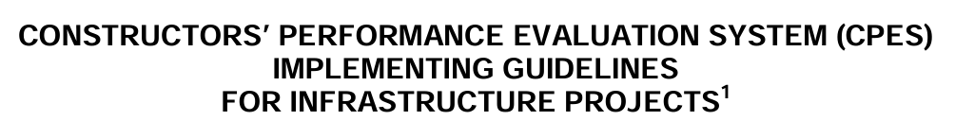
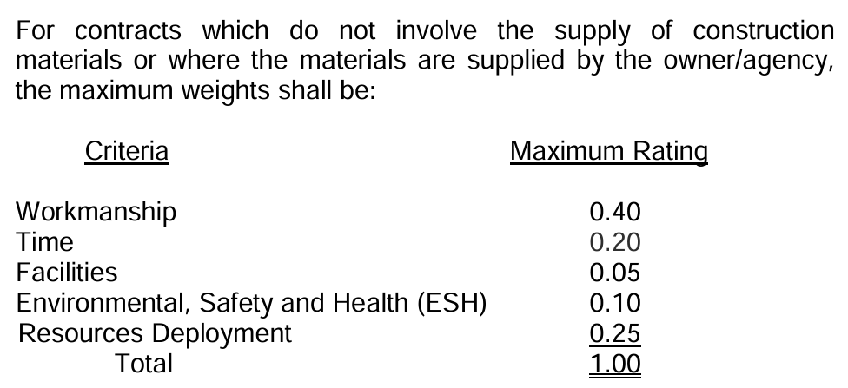
Click for the complete file →
CONSTRUCTORS’ PERFORMANCE EVALUATION SYSTEM (CPES)

Slide 154
61. During construction, for contracts which do not involve the supply of construction materials or where the materials are supplied by the owner/agency, the maximum rating for Environmental, Safety and Health (ESH) shall be:
  0.40
  0.20
  0.05
  0.10

Slide 155
62. All of the following happens when the cetane number is too high, EXCEPT:
  a. Inadequate mixing of fuel and air, hence incomplete combustion
  b. Causes a very large, fast pressure rise at the start of combustion
  c. results in low thermal efficiency and a rough-running engine
  d. combustion will start too soon in the cycle

Slide 156
62. All of the following happens when the cetane number is too high, EXCEPT:
  a. Inadequate mixing of fuel and air, hence incomplete combustion
  b. Causes a very large, fast pressure rise at the start of combustion
  c. results in low thermal efficiency and a rough-running engine
  d. combustion will start too soon in the cycle
Notes:
A high cetane number means the fuel ignites quickly after injection, which is usually desirable in diesel engines. However, too high a cetane number can lead to:
Incomplete mixing of fuel and air (since combustion starts very early) → incomplete combustion
Lower thermal efficiency due to less-than-optimal combustion timing
Rough engine operation
Combustion starting too soon, which can reduce power and cause knocking
"Causes a very large, fast pressure rise at the start of combustion"
This happens when cetane number is too low, not too high.
With low cetane fuels, there’s a long ignition delay, allowing more fuel to accumulate before combustion starts.
When it finally ignites, it burns all at once — causing a sudden pressure spike, knocking, and engine damage.

Slide 157
63. By virtue of Executive Order No. 116, series 1987, the ___ was created to be responsible for the training of all agricultural extension workers and other AF clients.
  DA
  ATI
  PhilMech
  RAED

Slide 158
63. By virtue of Executive Order No. 116, series 1987, the ___ was created to be responsible for the training of all agricultural extension workers and other AF clients.
  DA
  ATI
  PhilMech
  RAED
Notes:
PhilMech – Focused on postharvest development and farm mechanization.
RAED – technical arm of the DA Regional Field Offices that focuses on agricultural engineering services.

Slide 159
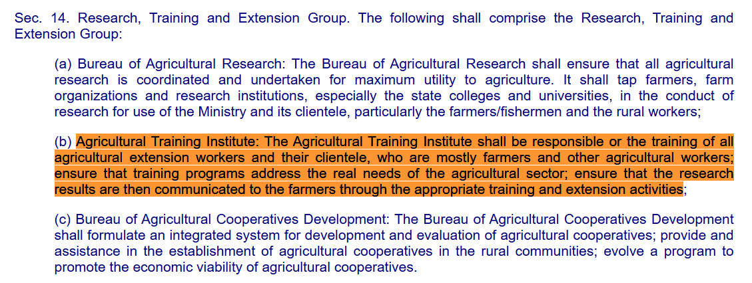
Executive Order No. 116

Slide 160
64. Determine the minimum capacity of a standby generator if it will be used to operate the following: Belt conveyor – 5kW, Hammer mill – 8 kW, Siever – 3 kW, Electronic weighing scale – 0.2 , lights – 1 KW, and exhaust fans – 0.6 KW. Assume that the starting power is 3X the running power for each of the equipment with electric motors and all the equipment have to be operated.
  24 kW
  79 kW
  53 kW
  36 kW

Slide 161
64. Determine the minimum capacity of a standby generator if it will be used to operate the following: Belt conveyor – 5Kw, Hammer mill – 8 KW, Siever – 3 KW, Electronic weighing scale – 0.2 KW, lights – 1 KW, and exhaust fans – 0.6 KW. Assume that the starting power is 3X the running power for each of the equipment with electric motors and all the equipment have to be operated.
  24 kW
  79 kW
  53 kW
  36 kW

Slide 162
65. Direct marketing is advisable if
  The total sales volume is small
  The market is scattered
  The product commands a high value per unit
  The product is highly perishable

Slide 163
65. Direct marketing is advisable if
  The total sales volume is small
  The market is scattered
  The product commands a high value per unit
  The product is highly perishable
Notes:
Direct marketing requires more effort in terms of time, labor, and logistics. It becomes more profitable and worthwhile if the product being sold has a high value per unit (e.g., artisanal cheese, organic honey, specialty coffee). This allows the seller to recover costs and earn a better profit margin without going through middlemen.
Total sales volume is small: Not necessarily ideal—direct marketing often involves significant time and effort per sale, which might not be worth it for low overall sales.
Market is scattered: Direct marketing works best when the market is concentrated and accessible.
(Sometimes correct) The product is highly perishable
It's true that if a product spoils easily (like lettuce, milk, or seafood), direct marketing can be useful.
However, if the market is far or the product has a low value per unit, direct selling can still be difficult.

Slide 164
66. It is the time needed for a mixture of fuel and oxidizer to react at a certain temperature and pressure.
  a. Clearance Period
  b. Combustion Reaction Time
  c. Mixture Period
  d. Ignition Delay Time

Slide 165
66. It is the time needed for a mixture of fuel and oxidizer to react at a certain temperature and pressure.
  a. Clearance Period
  b. Combustion Reaction Time
  c. Mixture Period
  d. Ignition Delay Time
Notes:
Ignition Delay Time is the time interval between the start of injection (or mixing) of the fuel-oxidizer mixture and the start of combustion. It reflects the chemical reaction delay under specific temperature and pressure conditions. This is important in engines and combustion systems because it affects performance, efficiency, and emissions.
a. Clearance Period – This refers to the small space between the piston and the cylinder head when the piston is at its topmost position (Top Dead Center) in an engine. It has nothing to do with reaction time or fuel-oxidizer mixtures. It's a mechanical term related to engine design, not combustion timing.
b. Combustion Reaction Time – This might sound close, but it's a non-standard or vague term. It could refer to the entire time combustion takes, but it's not a specific technical term in combustion theory.
c. Mixture Period – This would refer to the time during which fuel and oxidizer are being mixed before combustion. It doesn’t include the chemical reaction part. Mixing and reacting are two different phases. Ignition delay specifically refers to the delay before chemical reaction begins, not just the mixing.

Slide 166
67. It may be accomplished with a very heavy-duty moldboard or disc plow which inverts the soil, or with a chisel plow or subsoiler which shatters the soil.
  a. deep tillage
  b. earthmoving
  c. land forming
  d. land grading

Slide 167
67. It may be accomplished with a very heavy-duty moldboard or disc plow which inverts the soil, or with a chisel plow or subsoiler which shatters the soil.
  a. deep tillage
  b. earthmoving
  c. land forming
  d. land grading

Slide 168
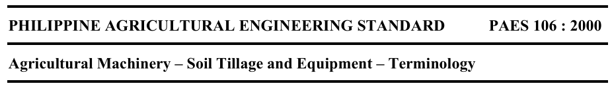
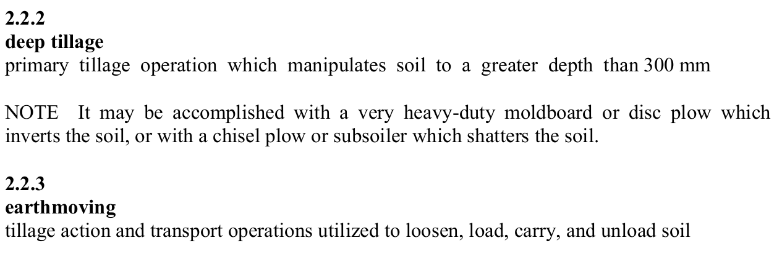
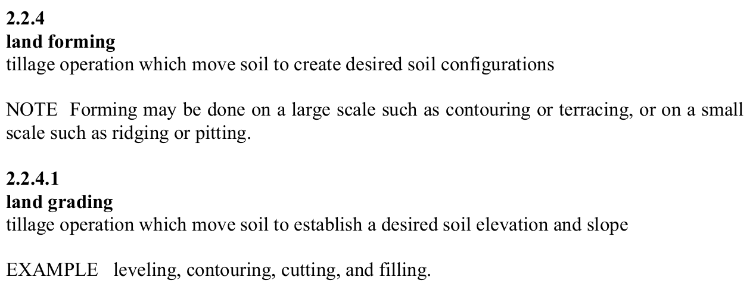

Slide 169
68. If a NSK 6200 single-row deep-groove ball bearing will be used to drive a pulley that delivers 119.8kgf, how many revolutions does the bearing last if the basic dynamic load of 6200 ball bearing is 400kgf?
  a. 37.22 x 10⁶ rev
  b. 14.95 x 10⁵ rev
  c. 25.39 x 10⁵ rev
  d. 46.33 x 10⁶ rev

Slide 171
68. If a NSK 6200 single-row deep-groove ball bearing will be used to drive a pulley that delivers 119.8kgf, how many revolutions does the bearing last if the basic dynamic load of 6200 ball bearing is 400kgf?
  a. 37.22 x 10⁶ rev
  b. 14.95 x 10⁵ rev
  c. 25.39 x 10⁵ rev
  d. 46.33 x 10⁶ rev

Slide 172
69. This occurs when fuel is injected into heated air and is burned as the surface of the stream, or droplets contact the air.
  a. Combustion by explosion
  b. Detonation
  c. Knocking
  d. Boundary combustion

Slide 173
69. This occurs when fuel is injected into heated air and is burned as the surface of the stream, or droplets contact the air.
  a. Combustion by explosion
  b. Detonation
  c. Knocking
  d. Boundary combustion

Slide 174
70. It prevents dangerous parts from being reached and protects the operator against accidents or hazards.
  Shield or cover
  Guard
  Casing
  Enclosure

Slide 175
70. It prevents dangerous parts from being reached and protects the operator against accidents or hazards.
  Shield or cover
  Guard
  Casing
  Enclosure

Slide 176
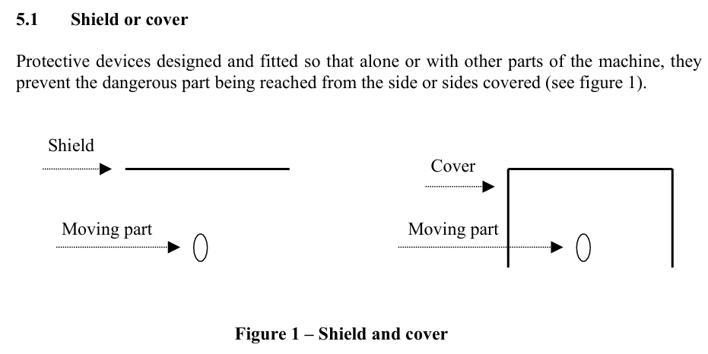

Slide 177
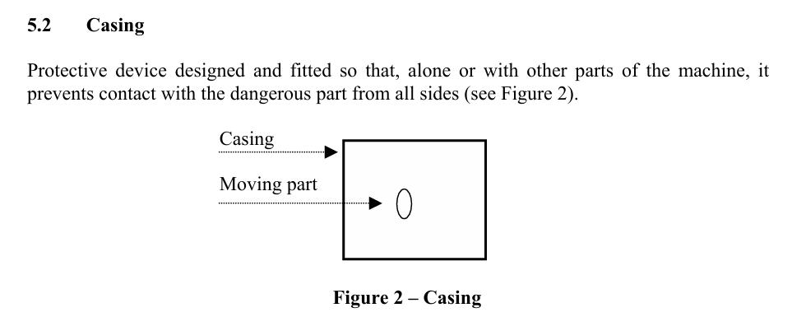

Slide 178
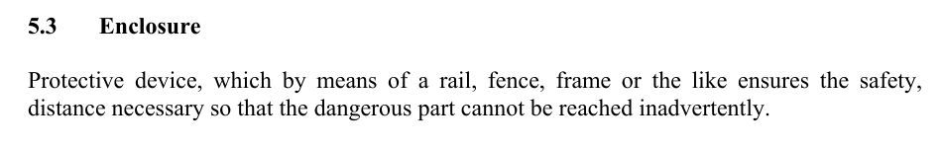

Slide 179
71. This Act shall be known as the "Sugarcane Industry Development Act of 2015".
  RA 6541
  RA 10912
  RA 10659
  RA 11285

Slide 180
71. This Act shall be known as the "Sugarcane Industry Development Act of 2015".
  RA 6541
  RA 10912
  RA 10659
  RA 11285
Notes:
RA 6541 – National Building Code of the Philippines
RA 10912 – Continuing Professional Development (CPD) Act of 2016
RA 11285 – Energy Efficiency and Conservation Act

Slide 181
72. All of the following refers to a group of 2 or more ABE which is registered with the SEC for the purpose of engaging in the practice of Agricultural and Biosystems Engineering, EXCEPT:
  Firm
  Partnership
  Association
  Employer

Slide 182
72. All of the following refers to a group of 2 or more ABE which is registered with the SEC for the purpose of engaging in the practice of Agricultural and Biosystems Engineering, EXCEPT:
  Firm
  Partnership
  Association
  Employer

Slide 183
73. When the piston rings’ gaps are facing in the same direction, this may result in:
  a. Engine fails to develop full power
  b. Engine knocking
  c. Excessive oil consumption
  d. Excessive fuel consumption

Slide 184
73. When the piston rings’ gaps are facing in the same direction, this may result in:
  a. Engine fails to develop full power
  b. Engine knocking
  c. Excessive oil consumption
  d. Excessive fuel consumption

Slide 185
74. Walking-Type Agricultural Tractor — Specifications — Part 1: Pull-type
  a. PNS/BAFS 345:2022
  b. PNS/BAFS 346:2022
  c. PNS/BAFS 347:2022
  d. PNS/BAFS 348:2022

Slide 186
74. Walking-Type Agricultural Tractor — Specifications — Part 1: Pull-type
  a. PNS/BAFS 345:2022
  b. PNS/BAFS 346:2022
  c. PNS/BAFS 347:2022
  d. PNS/BAFS 348:2022

Slide 187
75. This is when products are made available where they are most wanted.
  Form
  Time
  Place
  Possession

Slide 188
75. This is when products are made available where they are most wanted.
  Form
  Time
  Place
  Possession
Notes:
Place utility refers to the value created when products are made available at the location where they are most wanted or needed by consumers. It ensures that goods are accessible in the right geographic location, improving convenience and likelihood of purchase.
Form – Utility created by changing raw materials into finished products (e.g., turning wheat into bread).
Time – Utility created by having a product available when it is needed (e.g., umbrellas during rainy season).
Possession – Utility created by transferring ownership from seller to buyer (e.g., through purchase or rental).

Slide 189
76. The Defects Liability Period shall be _____ from project completion up to final acceptance by the Government.
  3 months
  6 months
  1 year
  2 years

Slide 190
76. The Defects Liability Period shall be _____ from project completion up to final acceptance by the Government.
  3 months
  6 months
  1 year
  2 years
Notes:
RA 9184

Slide 191
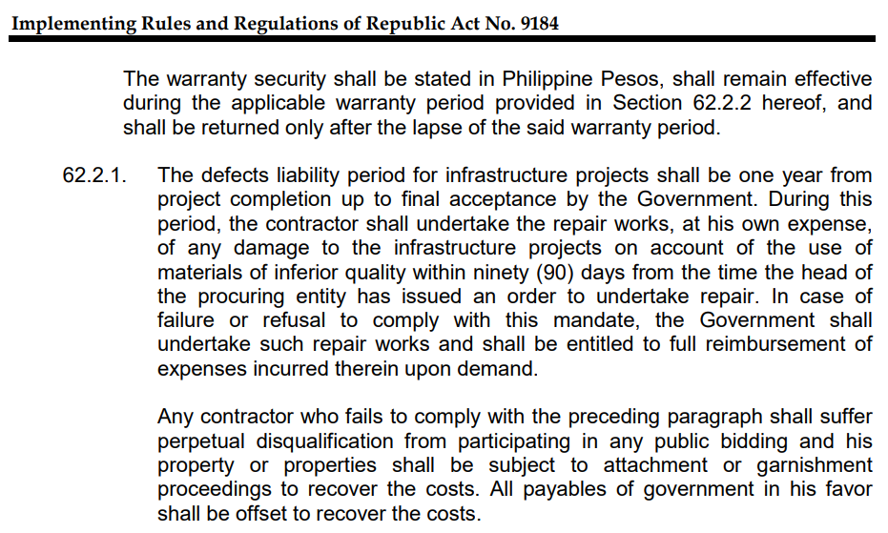
https://www.dilg.gov.ph/PDF_File/issuances/republic_acts/RA_9184.PDF

Slide 192
77. It is a component of the sprayer that evens out the fluctuations of the fluid pressure and induces more uniform flow of the sprayed liquid.
  nozzle
  pressure chamber
  spray tank
  cut-off valve

Slide 193
77. It is a component of the sprayer that evens out the fluctuations of the fluid pressure and induces more uniform flow of the sprayed liquid.
  nozzle
  pressure chamber
  spray tank
  cut-off valve

Slide 194
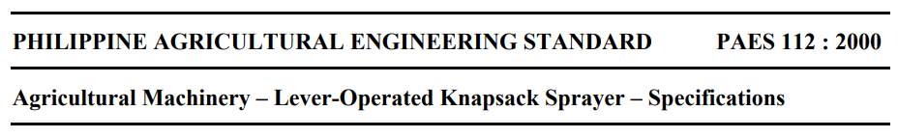
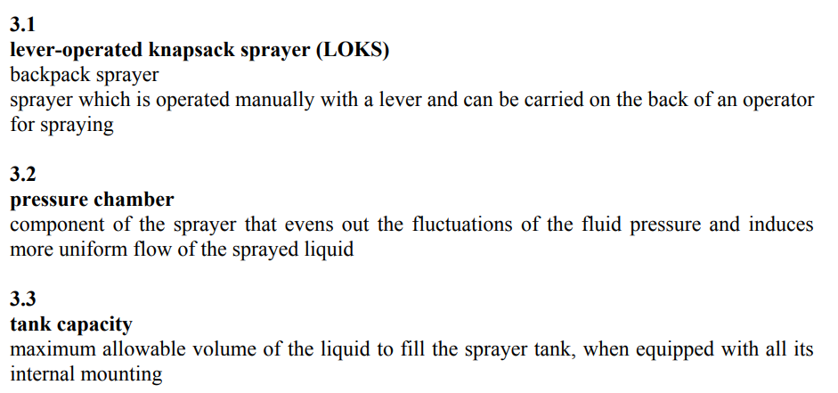

Slide 195
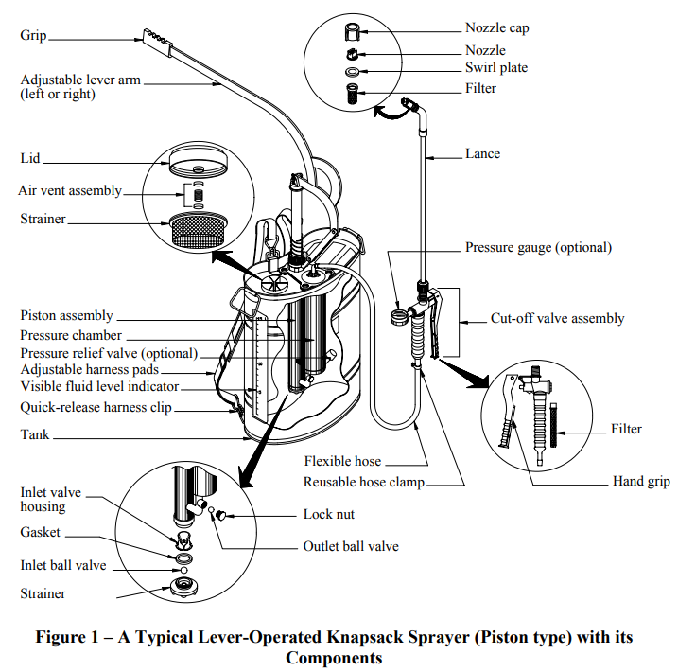

Slide 196
78. A 6-meter wide harvester is harvesting corn at a rate of 100 kg per minute. The effective width of the machine is 90% of its width. If it runs at a speed of 2.5kph, what is its effective field capacity? Assume a machine field efficiency of 70%.
  1.35 ha/hr
  1.93 ha/hr
  0.95 ha/hr
  1.05 ha/hr

Slide 197
78. A 6-meter wide harvester is harvesting corn at a rate of 100 kg per minute. The effective width of the machine is 90% of its width. If it runs at a speed of 2.5kph, what is its effective field capacity? Assume a machine field efficiency of 70%.
  1.35 ha/hr
  1.93 ha/hr
  0.95 ha/hr
  1.05 ha/hr

Slide 198
79. The required CPD credits units for the ABE profession for Senior Citizen/PWD.
5
10
15
20

Slide 199
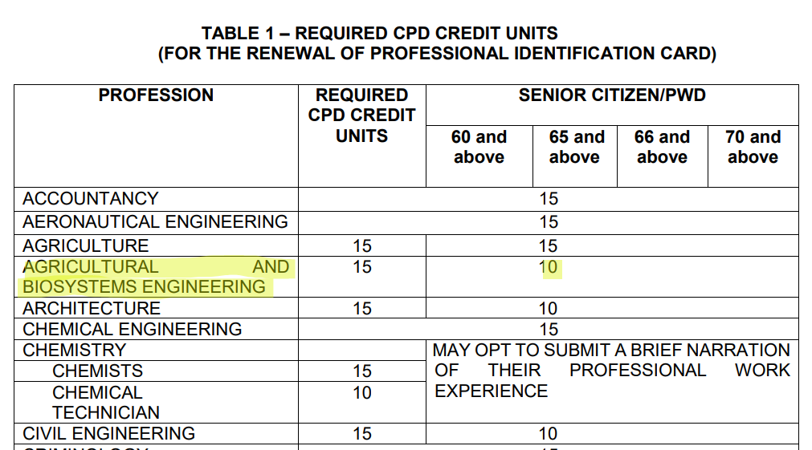
https://www.prc.gov.ph/sites/default/files/CPD-FAQs-2020.pdf

Slide 200
79. The required CPD credits units for the ABE profession for Senior Citizen/PWD.
5
10
15
20

Slide 201
80. Convert 240º to radians.
  4/3π
  2π
  π
  1/4π

Slide 202
80. Convert 240º to radians.
  4/3π
  2π
  π
  1/4π
Notes:
$$2π radians=360°$$
$$240∗\frac{π}{180}=4/3π$$

Slide 203
81. It is the weight of paddy that the rice mill can process per total milling time.
  milling recovery
  input capacity
  milling efficiency
  milling capacity

Slide 204
81. It is the weight of paddy that the rice mill can process per total milling time.
  milling recovery
  input capacity
  milling efficiency
  milling capacity

Slide 205
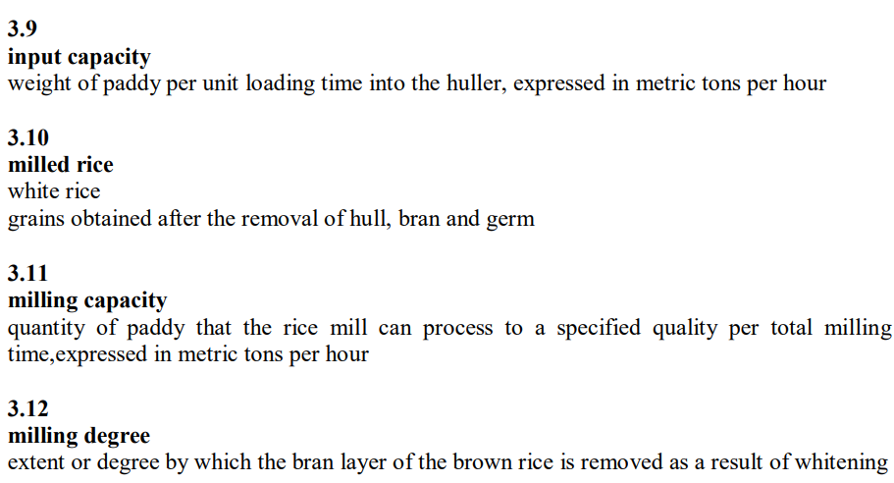
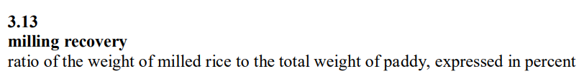

Slide 206
82. A 300-hectare coconut plantation is designed to supply coconut oil for a biodiesel plant. There are 100 trees of coconut per hectare. How many liters of biodiesel can be produced by the plant considering a 90% conversion efficiency? Each tree has a capacity to produce an average of 10 nuts per month and 1 liter of coconut oil per 10 nuts.
  54 000 L
  27 000 L
  30 000 L
  60 000 L

Slide 207
82. A 300-hectare coconut plantation is designed to supply coconut oil for a biodiesel plant. There are 100 trees of coconut per hectare. How many liters of biodiesel can be produced by the plant considering a 90% conversion efficiency? Each tree has a capacity to produce an average of 10 nuts per month and 1 liter of coconut oil per 10 nuts.
  54 000 L
  27 000 L
  30 000 L
  60 000 L
Notes:
300*100*90%

Slide 208
83. The following includes the agencies that will promulgate the rules and regulations to effectively implement the provisions of the Republic Act No. 11203, EXCEPT:
  DA
  NEDA
  DBM
  PCIC

Slide 209
83. The following includes the agencies that will promulgate the rules and regulations to effectively implement the provisions of the Republic Act No. 11203, EXCEPT:
  DA
  NEDA
  DBM
  PCIC

Slide 210


Slide 211
84. The Blooms Consulting has a contract to design a major park project which has an estimated of Php 2.8 million. Annual upkeep costs are estimated at Php 150,000. Benefits of Php 370,000 per year and disbenefits of Php 70,000 per year have also been identified. Using a discount rate of 6% per year, calculate the conventional B/C ratio.
  1.07
  1.66
  1.02
  1.49

Slide 212
84. The Blooms Consulting has a contract to design a major park project which has an estimated of Php 2.8 million. Annual upkeep costs are estimated at Php 150,000. Benefits of Php 370,000 per year and disbenefits of Php 70,000 per year have also been identified. Using a discount rate of 6% per year, calculate the conventional B/C ratio.
  1.07
  1.66
  1.02
  1.49

Slide 213
85. It is defined as a process of translating future value into their present value worth by applying a factor that reflects the diminishing value of the same amount of money as one moves further into the future.
  a. Benefits-Cost Ratio
  b. Discounting
  c. Net Present Value
  d. Return of Investment

Slide 214
85. It is defined as a process of translating future value into their present value worth by applying a factor that reflects the diminishing value of the same amount of money as one moves further into the future.
  a. Benefits-Cost Ratio
  b. Discounting
  c. Net Present Value
  d. Return of Investment
Notes:
Discounting is the process of translating future values into their present value (PV) by applying a discount rate. This method reflects the diminishing value of money over time, meaning that money in the future is worth less than money today due to factors like inflation, risk, and the opportunity cost of capital.
a. Benefits-Cost Ratio: This is a ratio that compares the benefits of a project to its costs. It doesn’t involve the process of translating future values into present values.
c. Net Present Value (NPV): NPV is the difference between the present value of cash inflows (benefits) and present value of cash outflows (costs) over time. While NPV uses discounting in its calculation, the definition in the question specifically refers to the process of discounting, not the outcome (which is NPV).
d. Return on Investment (ROI): ROI is a financial metric used to evaluate the profitability of an investment. It doesn’t involve discounting future values or converting them to present value.

Slide 215
86. Which of the following is NOT true about the operators’ responsibility for safety.
  a. Always keep shields and guards over power shafts, chains and gears.
  b. Make sure the tractor and others are in gear before starting.
  c. When pulling heavy objects, hitch under center of the tractor.
  d. Do not get in front of moving machines to make adjustments.

Slide 216
86. Which of the following is NOT true about the operators’ responsibility for safety.
  a. Always keep shields and guards over power shafts, chains and gears.
  b. Make sure the tractor and others are in gear before starting.
  c. When pulling heavy objects, hitch under center of the tractor.
  d. Do not get in front of moving machines to make adjustments.
Notes:
When starting a tractor, it is crucial that the tractor is in neutral gear, not in gear. Starting the tractor when it is in gear could cause it to move unexpectedly, posing a serious risk of injury or damage. This is why it’s important to make sure the tractor is in neutral before starting.
Option a: "Always keep shields and guards over power shafts, chains, and gears": This is true because keeping safety guards in place protects operators from coming into contact with dangerous moving parts. Safety shields prevent accidents and injuries.
Option c: "When pulling heavy objects, hitch under the center of the tractor": This is true because hitching at the correct point, usually close to the tractor's center, improves stability and control when pulling heavy loads. It helps prevent tipping or loss of control during operation.
Option d: "Do not get in front of moving machines to make adjustments": This is also true because standing in front of a moving machine exposes the operator to danger from moving parts. It is important to ensure the machine is stopped and powered off before making adjustments.

Slide 217
87-89 Ms. Colet plans to open a bread shop and identifies some of the costs the business might incur.
87. Identify the type of cost: mortgage
  a. Fixed cost
  b. Variable cost
  c. Direct cost
  d. Indirect cost

Slide 218
87-89 Ms. Colet plans to open a bread shop and identifies some of the costs the business might incur.
87. Identify the type of cost: mortgage
  a. Fixed cost
  b. Variable cost
  c. Direct cost
  d. Indirect cost
Notes:
A mortgage is a type of loan specifically used to purchase property, such as a home or commercial real estate. It's typically a long-term loan where the property being purchased serves as collateral (security) for the loan.
A mortgage is a fixed cost because it involves regular, consistent payments that do not vary based on the level of production or business activity. These payments are typically the same amount every month regardless of how much or how little a business produces or sells.
Variable cost: Variable costs change depending on the level of production or business activity. Examples include raw materials or direct labor costs that fluctuate with production volume. A mortgage does not change based on production, so it’s not a variable cost.
Direct cost: Direct costs are expenses that can be directly attributed to the production of goods or services, such as materials or labor directly involved in manufacturing. A mortgage is not directly tied to production, so it’s not a direct cost.
Indirect cost: Indirect costs are expenses that are not directly tied to the production of goods or services, such as utilities, office rent, or administrative salaries. A mortgage could be considered an indirect cost if it’s related to office or building space, but in most cases, it is considered a fixed cost for its regular, predictable nature.

Slide 219
88. Identify the type of cost: raw materials (sugar, butter, flour)
  a. Fixed cost
  b. Variable cost
  c. Direct cost
  d. Indirect cost
Notes:
Raw materials such as sugar, butter, and flour are considered variable costs because their total cost varies directly with the level of production. As Ms. Colet makes more bread, she will need more sugar, butter, and flour. So, the more bread she bakes, the more raw materials she needs, which makes these costs variable.
Fixed cost: Fixed costs do not change with the level of production. Examples include rent, salaries of permanent employees, and insurance. Raw materials are not fixed because their usage increases with production.
Direct cost: While raw materials are direct costs (they can be directly traced to the production of the bread), the more precise classification here is variable cost because these costs change based on production volume. Since the question is asking about costs that vary with production, variable cost is a better fit.
Indirect cost: Indirect costs are those that cannot be directly attributed to a specific product. Examples include utilities, administrative expenses, or rent. Raw materials are directly involved in making bread, so they are not indirect costs.

Slide 220
88. Identify the type of cost: raw materials (sugar, butter, flour)
  a. Fixed cost
  b. Variable cost
  c. Direct cost
  d. Indirect cost

Slide 221
89. Identify the type of cost: baker’s labor
  a. Fixed cost
  b. Variable cost
  c. Direct cost
  d. Indirect cost

Slide 222
89. Identify the type of cost: baker’s labor
  a. Fixed cost
  b. Variable cost
  c. Direct cost
  d. Indirect cost

Slide 223
90. It begins with an existing design but the final result may quietly differ from the initial product.
  a. Empirical design
  b. Original design
  c. Adaptive design
  d. Development design

Slide 224
90. It begins with an existing design but the final result may quietly differ from the initial product.
  a. Empirical design - based on experience and trial and error
  b. Original design - initial concept
  c. Adaptive design - focuses on responding to changing conditions
  d. Development design

Slide 225
91. When the color of the lubricating oil is carried into the combustion chamber of the engine, the color of smoke will be _____ .
  black
  blue
  gray
  AOTA

Slide 226
91. When the color of the lubricating oil is carried into the combustion chamber of the engine, the color of smoke will be _____ .
  black
  blue
  gray
  AOTA

Slide 228
92. Consider that the maximum load on a structure is known with an uncertainty of ± 25 percent, and the load causing failure is ± 20 percent. Determine the design factor.
  1.41
  1.60
  1.56
  1.07

Slide 229
92. Consider that the maximum load on a structure is known with an uncertainty of ± 25 percent, and the load causing failure is ± 20 percent. Determine the design factor.
  1.41
  1.60
  1.56
  1.07
Notes:
$$\frac{1−.25}{1+.20}$$

Slide 230
93. A general term that refers to the mating of cylindrical parts.
  Clearance
  Tolerance
  Interference
  Allowance

Slide 231
93. A general term that refers to the mating of cylindrical parts.
  Clearance
  Tolerance
  Interference
  Allowance

Slide 232
For Items 94-97
Juan will plow the field of 120m wide and 426.4 feet long using a carabao and moldboard plow with a 10-inch width of cut. His speed of plowing is 2mph.
94. How long will he finish plowing if he plows along the length of the field with no headland left unplowed?
  18.77 hrs
  19.08 hrs
  16.04 hrs
  21.85 hrs

Slide 233
For Items 94-97
Juan will plow the field of 120m wide and 426.4 feet long using a carabao and moldboard plow with a 10-inch width of cut. His speed of plowing is 2mph.
94. How long will he finish plowing if he plows along the length of the field with no headland left unplowed?
  18.77 hrs
  19.08 hrs
  16.04 hrs
  21.85 hrs

Slide 234
For Items 94-97
Juan will plow the field of 120m wide and 426.4 feet long using a carabao and moldboard plow with a 10-inch width of cut. His speed of plowing is 2mph.
95. How long will it take for Juan to finish plowing if he plows along the width of the field with 2m headland unplowed?
  18.77 hrs
  19.08 hrs
  16.04 hrs
  18.32 hrs

Slide 235


For Items 94-97
Juan will plow the field of 120m wide and 426.4 feet long using a carabao and moldboard plow with a 10-inch width of cut. His speed of plowing is 2mph.
95. How long will it take for Juan to finish plowing if he plows along the width of the field with 2m headland unplowed?
  18.77 hrs
  19.08 hrs
  16.04 hrs
  18.32 hrs
$$\frac{426.4ft}{10 in×\frac{1ft}{12 in}}=512 rows$$
$$\frac{512 rows×\frac{(120 m−2m) ×\frac{3.28ft}{1 row}}{row} }{2\frac{mile}{hr}×\frac{5280 ft}{mile}}=18.77 hrs$$

Slide 236
For Items 94-97
Juan will plow the field of 120m wide and 426.4 feet long using a carabao and moldboard plow with a 10-inch width of cut. His speed of plowing is 2mph.
96. Determine Juan’s plowing capacity.
  0.064 ha/hr
  0.082 ha/hr
  0.070 ha/hr
  0.057 ha/hr

Slide 237

For Items 94-97
Juan will plow the field of 120m wide and 426.4 feet long using a carabao and moldboard plow with a 10-inch width of cut. His speed of plowing is 2mph.
96. Determine Juan’s plowing capacity.
  0.064 ha/hr
  0.082 ha/hr
  0.070 ha/hr
  0.057 ha/hr
$$\frac{\left(2\frac{mile}{hr}×\frac{1.609 km}{1 mile}\right)\left(10 in×\frac{0.0254 m}{1 in}\right)}{10}=0.082 ha/hr$$

Slide 238
97. A farmer uses a hand tractor with 20cm moldboard plow. How many kilometers must he walk to plow one hectare?
  500,000 m
  5 km
  5 ha
  AOTA

Slide 239

97. A farmer uses a hand tractor with 20cm moldboard plow. How many kilometers must he walk to plow one hectare?
  500,000 m
  5 km
  5 ha
  AOTA
$$\frac{10,000 m^{2}}{0.2 m}=50,000 m=50 km$$

Slide 240
98. The distance between the horizontal supporting plane surface and the horizontal plane touching the uppermost part of the machine.
  a. overall height
  b. overall length
  c. overall width
  d. overall clearance

Slide 241
98. The distance between the horizontal supporting plane surface and the horizontal plane touching the uppermost part of the machine.
  a. overall height
  b. overall length
  c. overall width
  d. overall clearance
Notes:
Overall height refers to the vertical distance from the horizontal supporting surface to the highest point of the machine. This would include any protruding parts on top.
Overall length refers to the horizontal distance from the front to the back of the machine.
Overall width is the measurement from one side of the machine to the other, horizontally.
Overall clearance refers to the distance between the lowest part of the machine (often the ground) and the surface it sits on.

Slide 242
99. A type of power unit which has an energy conversion efficiency of 30%-36%.
  Electric motor
  Diesel engine
  Gasoline Engine
  AOTA

Slide 243
99. A type of power unit which has an energy conversion efficiency of 30%-36%.
  Electric motor
  Diesel engine
  Gasoline Engine
  AOTA
Notes:
Diesel engines typically have an energy conversion efficiency of 30% to 36%, sometimes even higher in optimized conditions.
Gasoline engines are generally less efficient, with efficiencies around 20% to 30%.
Electric motors, on the other hand, are much more efficient—typically 85% to 95%.

Slide 244
100. It measures productivity within a country's geographical boundaries.
  GDP
  GNP
  Inflation
  NFIA

Slide 245
100. It measures productivity within a country's geographical boundaries.
  GDP
  GNP
  Inflation
  NFIA
Notes:
GDP measures the total value of all goods and services produced within a country's geographical boundaries, regardless of who owns the production assets.
GNP (Gross National Product) measures the total income earned by a country's residents and businesses, including any income earned abroad, but excluding income earned by foreigners within the country.
Inflation is the rate at which the general level of prices for goods and services rises.
NFIA (Net Factor Income from Abroad) is part of the calculation of GNP and is the difference between income residents receive from abroad and income paid to foreign residents.

Slide 247
Read the learning materials from these websites:
https://rcef.philmech.gov.ph/
https://bafe.gov.ph/

